Slide 1
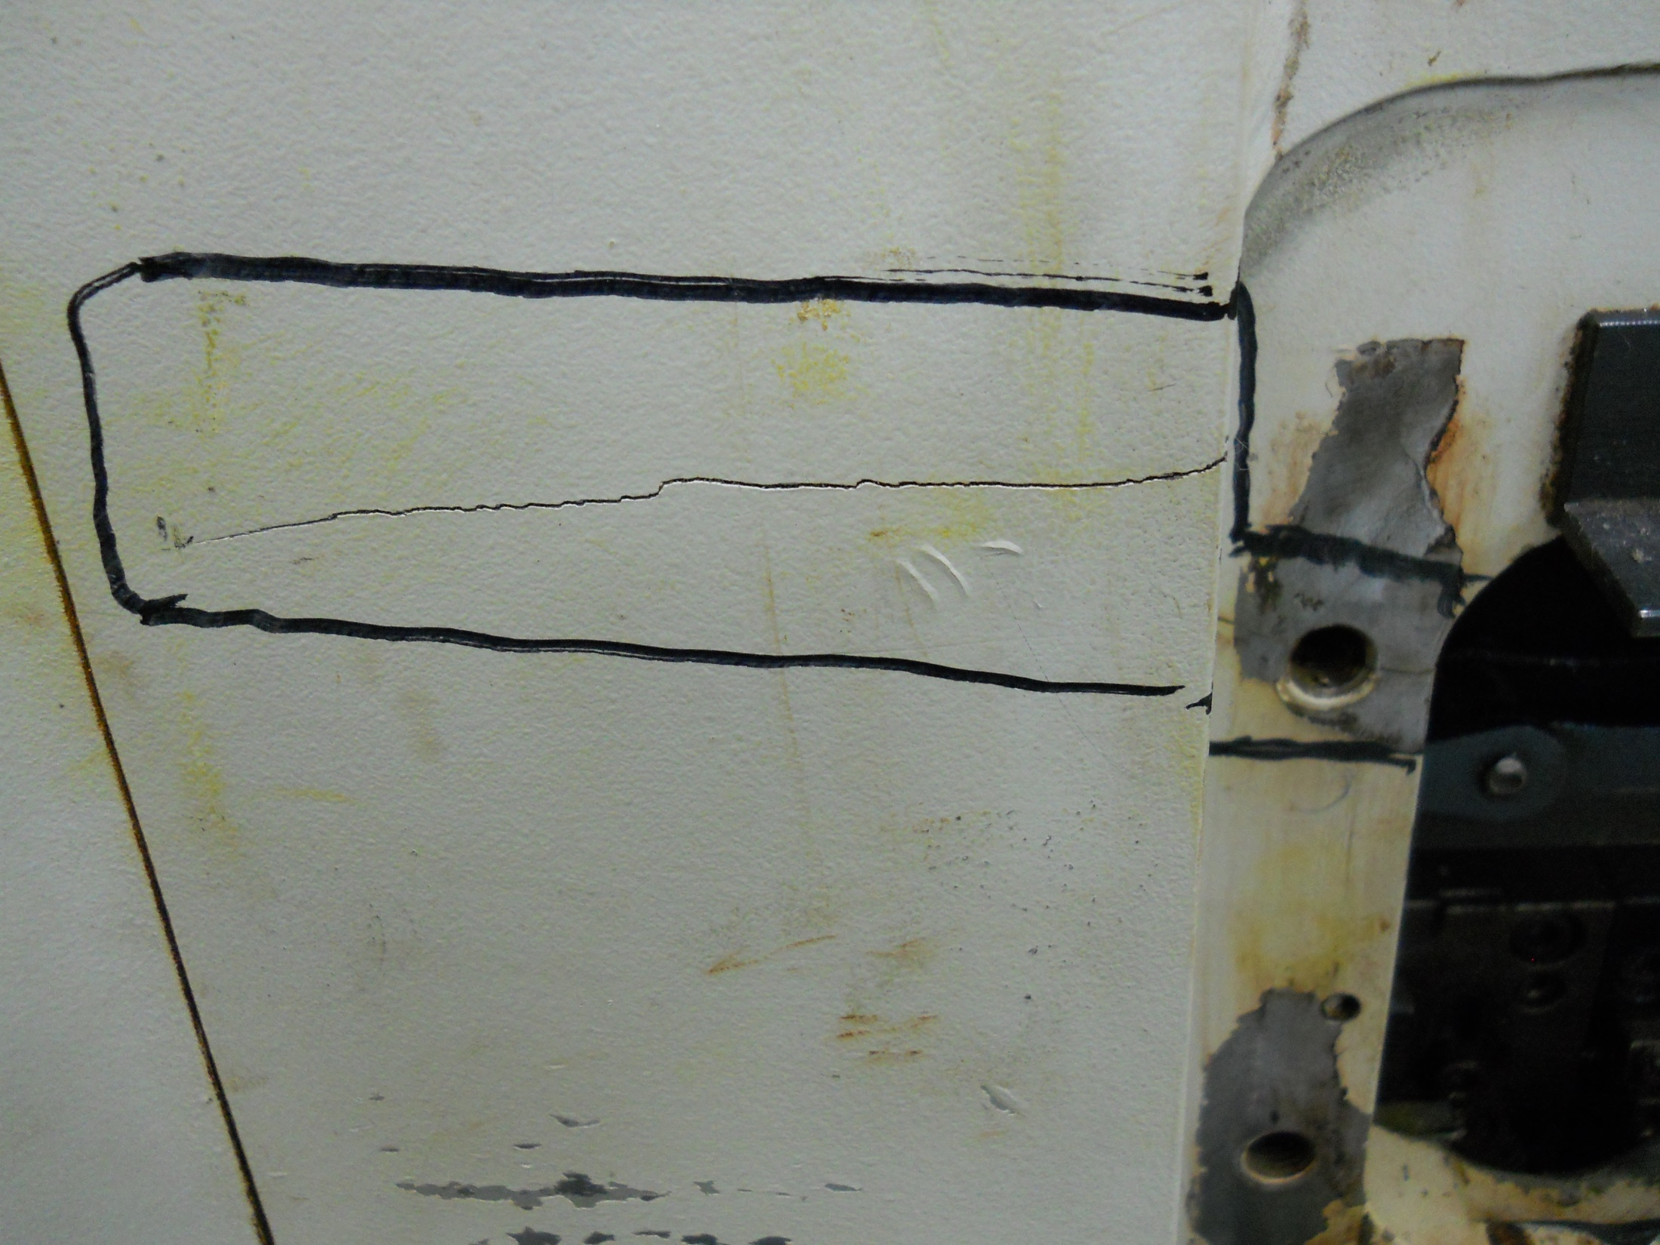

Slide 2
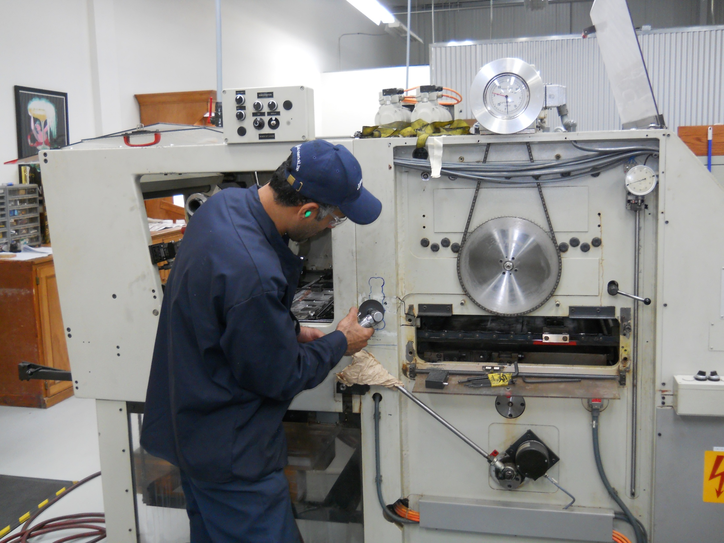

Slide 3
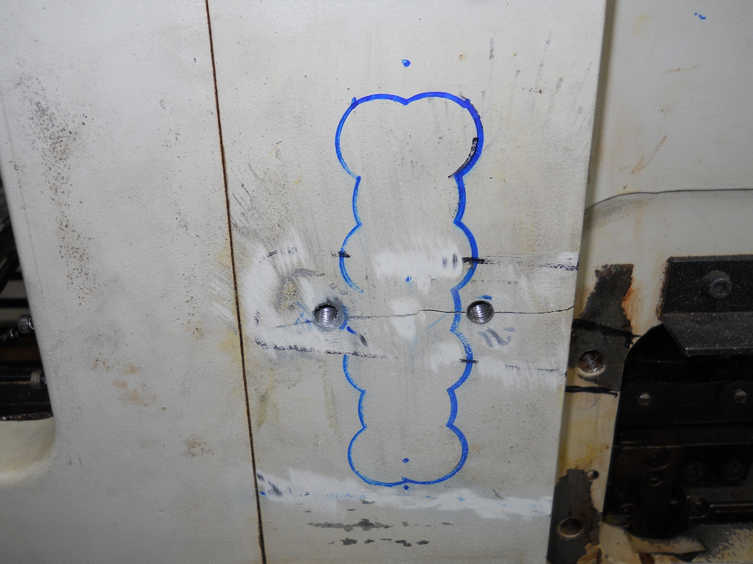
Laying out the Lock pattern which will add additional strength across the repair

Slide 4
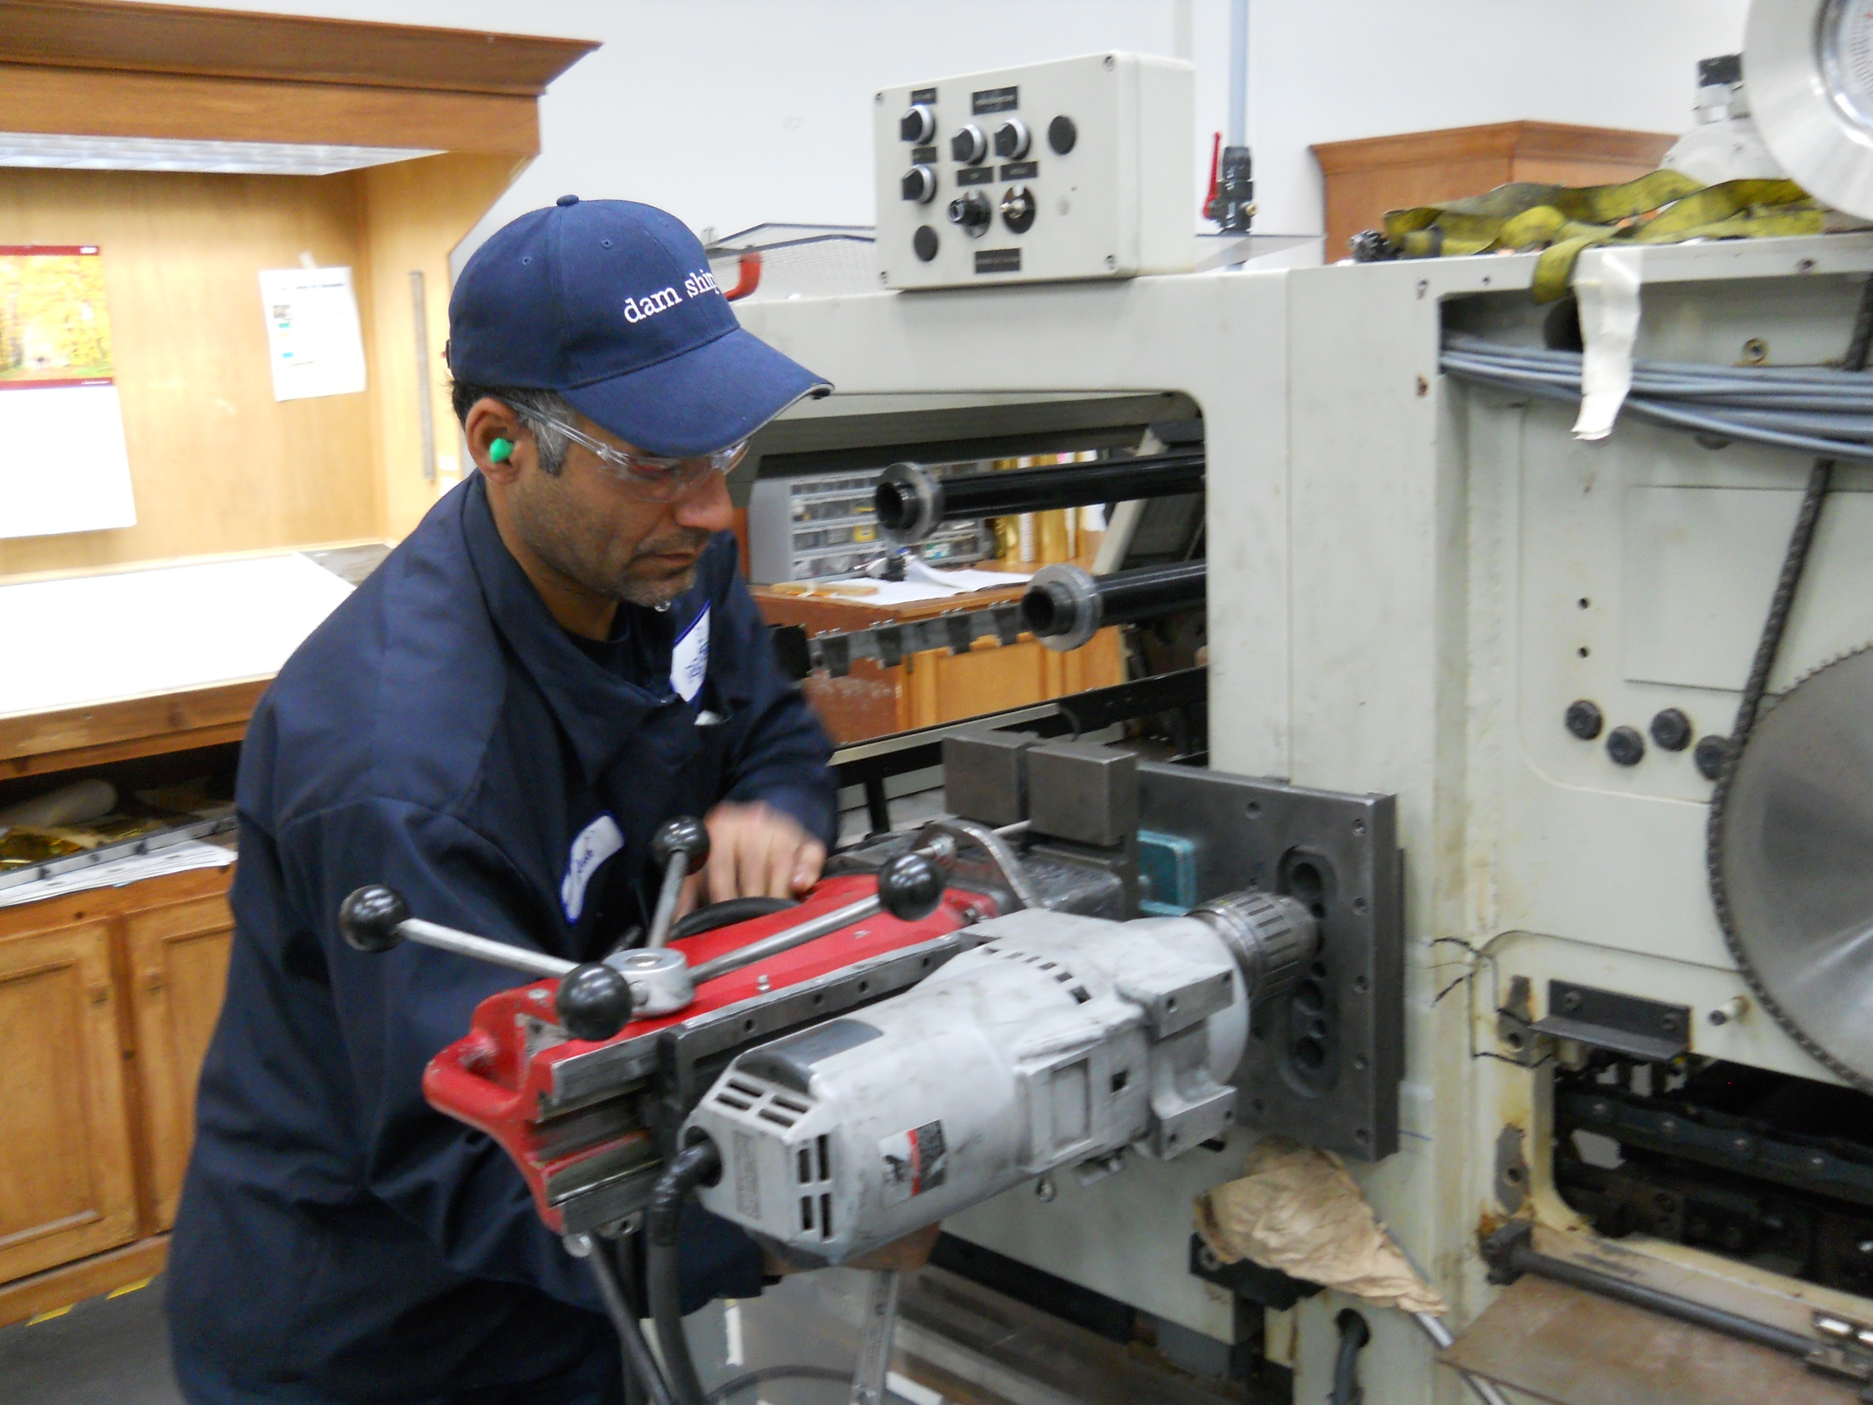
Drilling the lock pattern using a magnetic base drill.

Slide 5
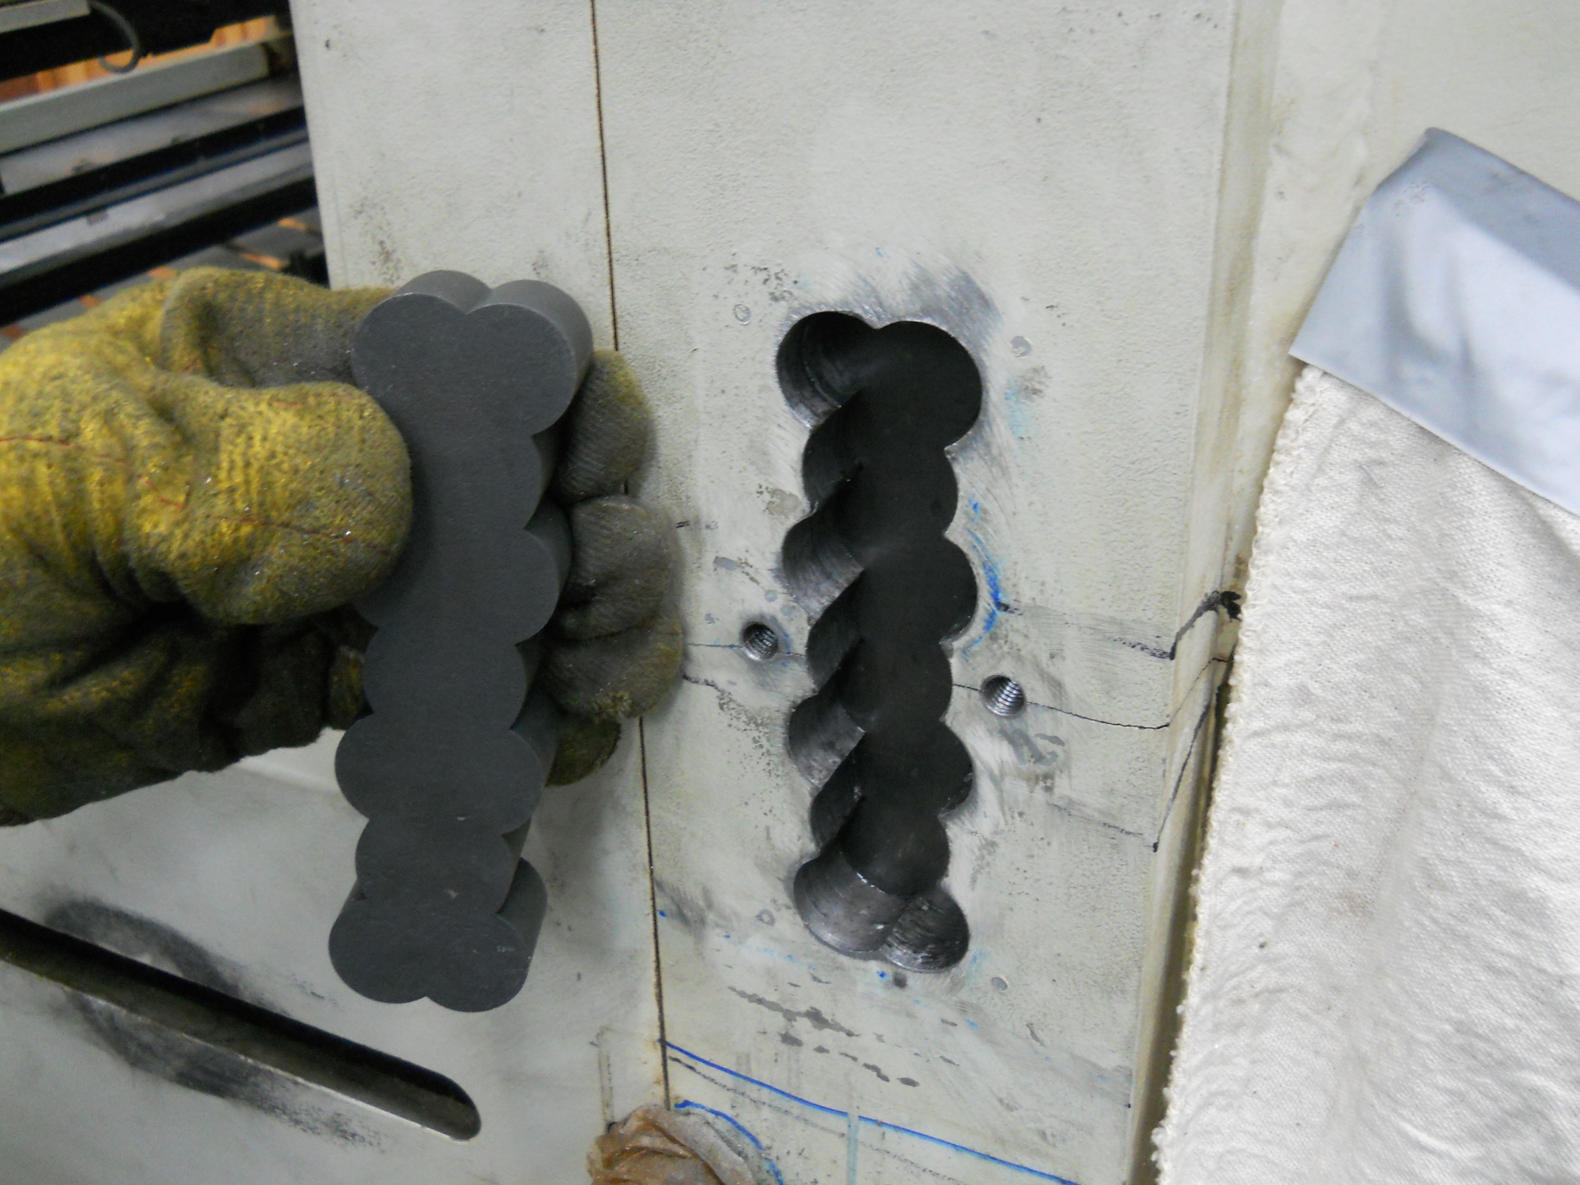
Lock pattern drilled out using the Mag base drill and precision drill jigs

Slide 6
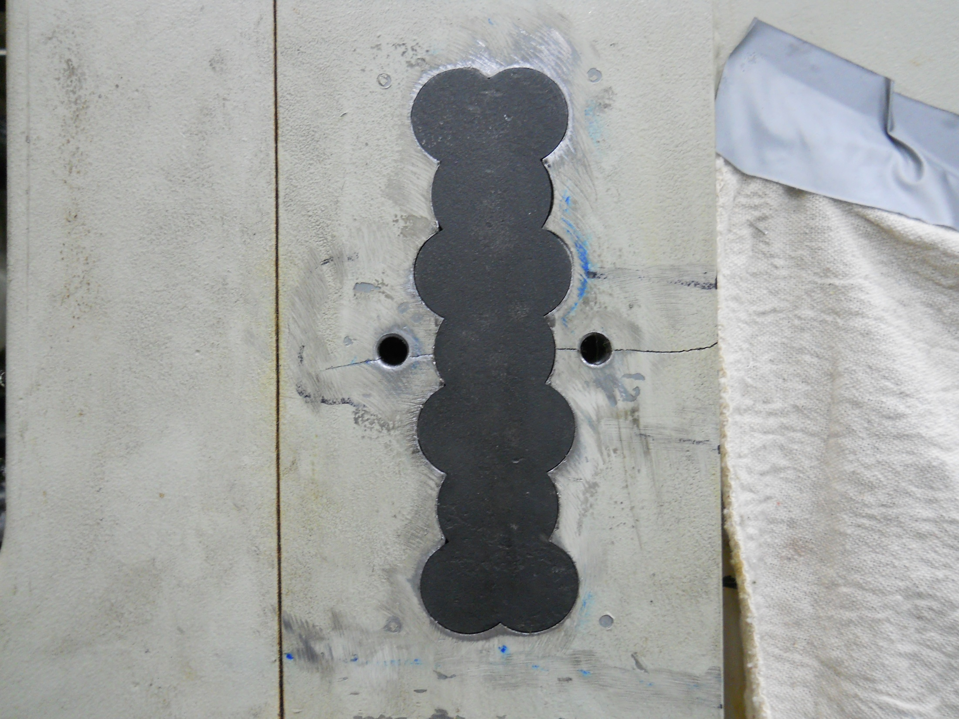
L60 lock installed and ready to have the crack stitched and hand finished.

Slide 7
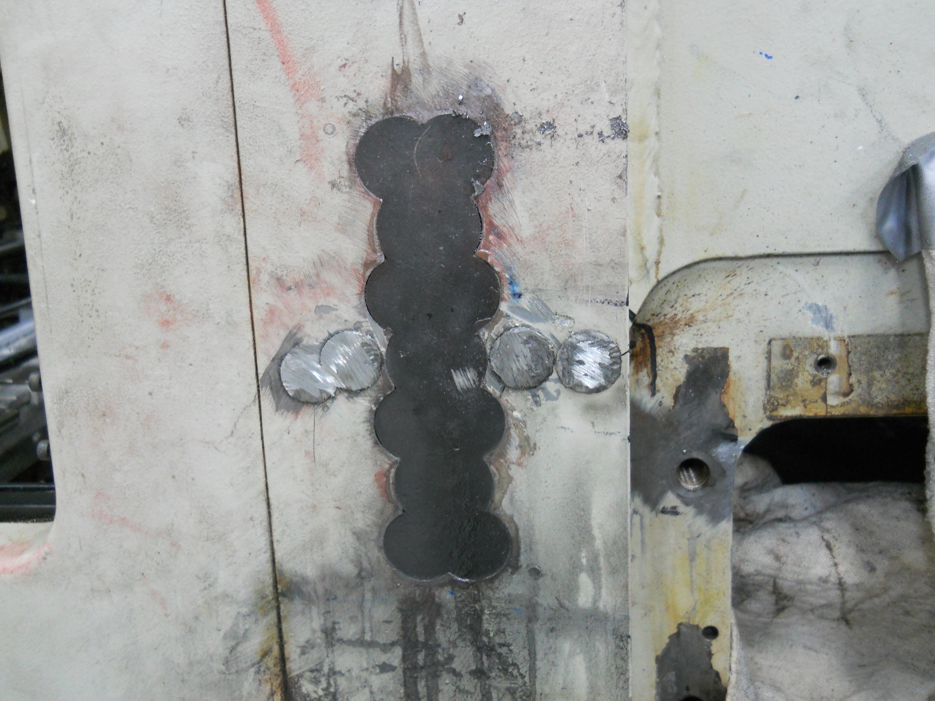
Using C4 Castmaster stitching pins to repair the crack.

Slide 8
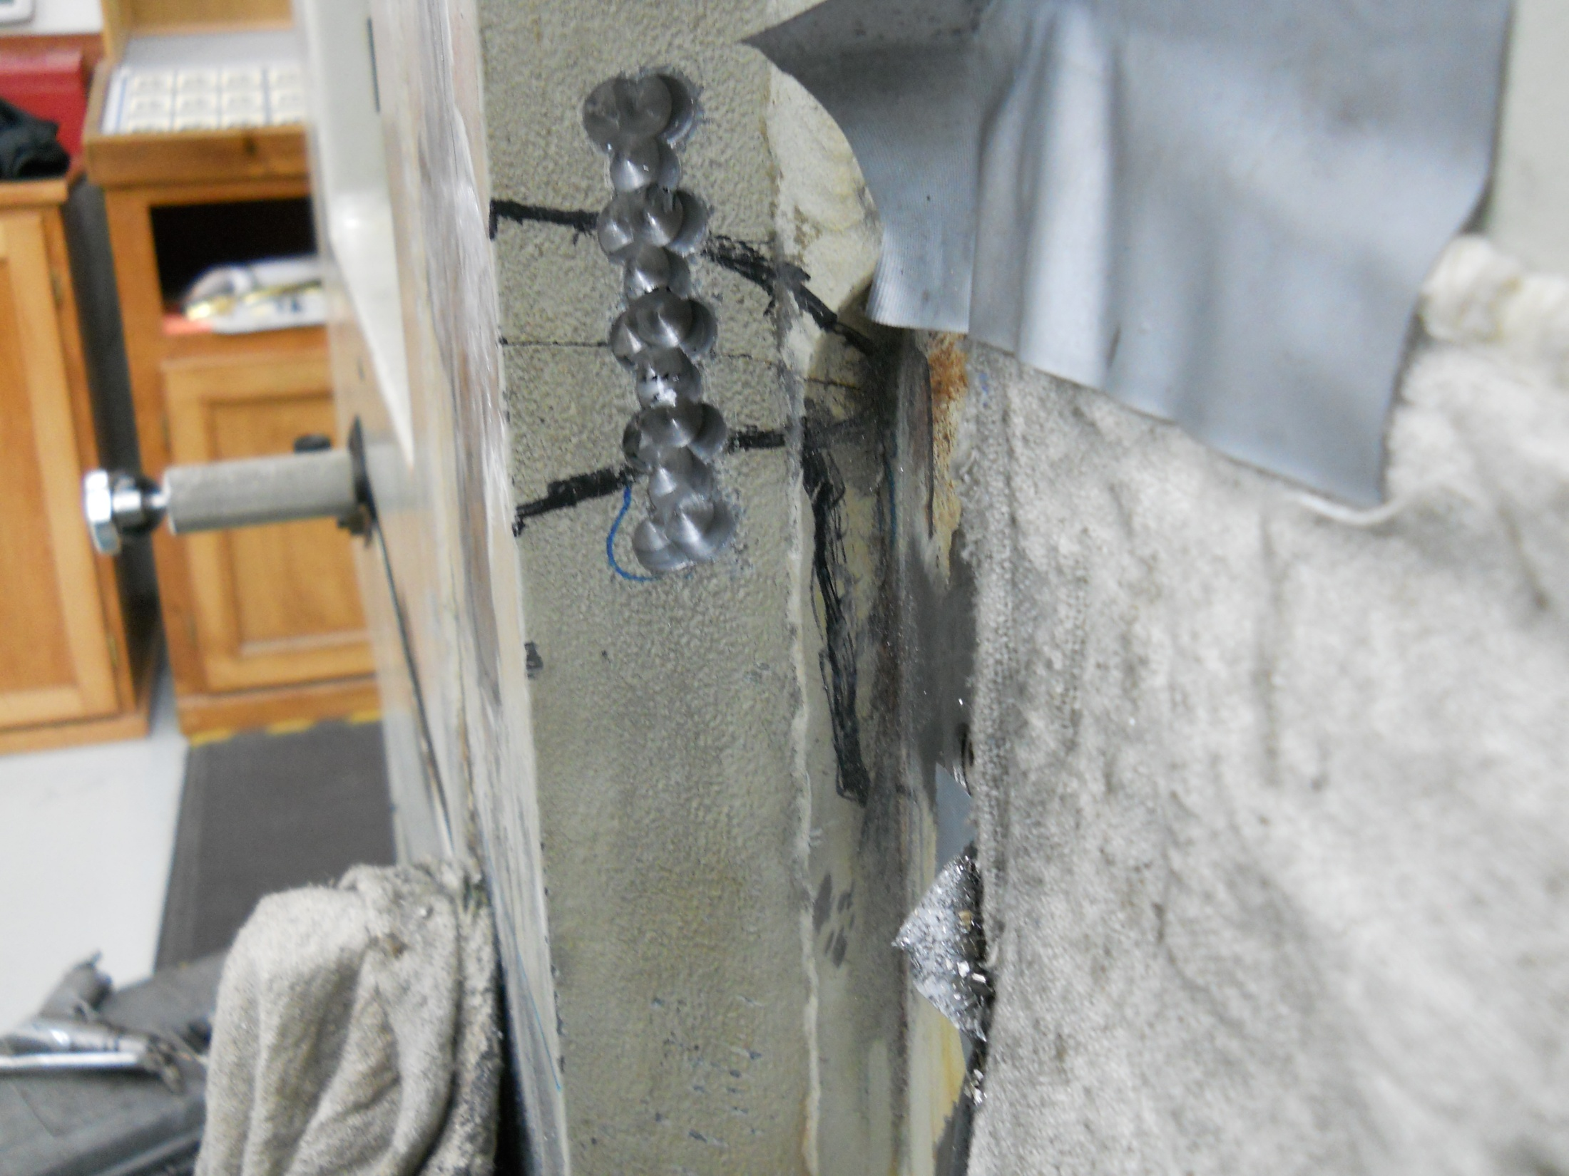
Installing a L30 lock on the side frame of the label press.

Slide 9
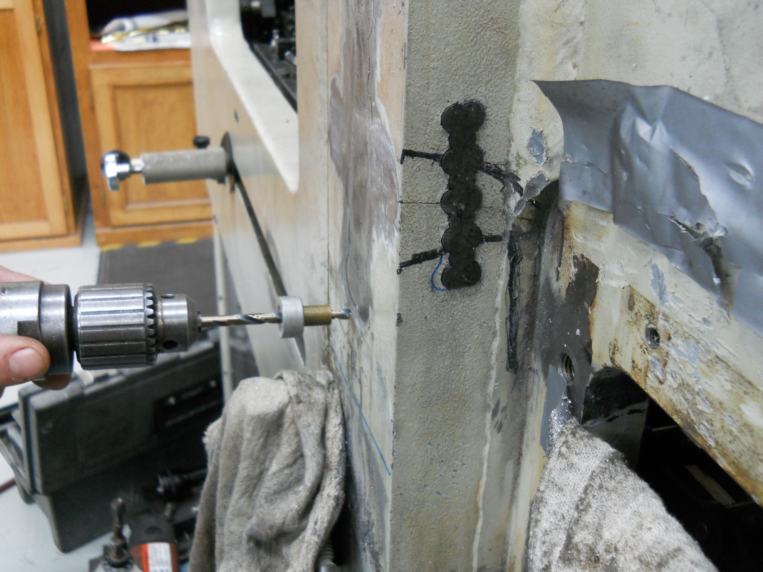
L30 lock installed

Slide 10
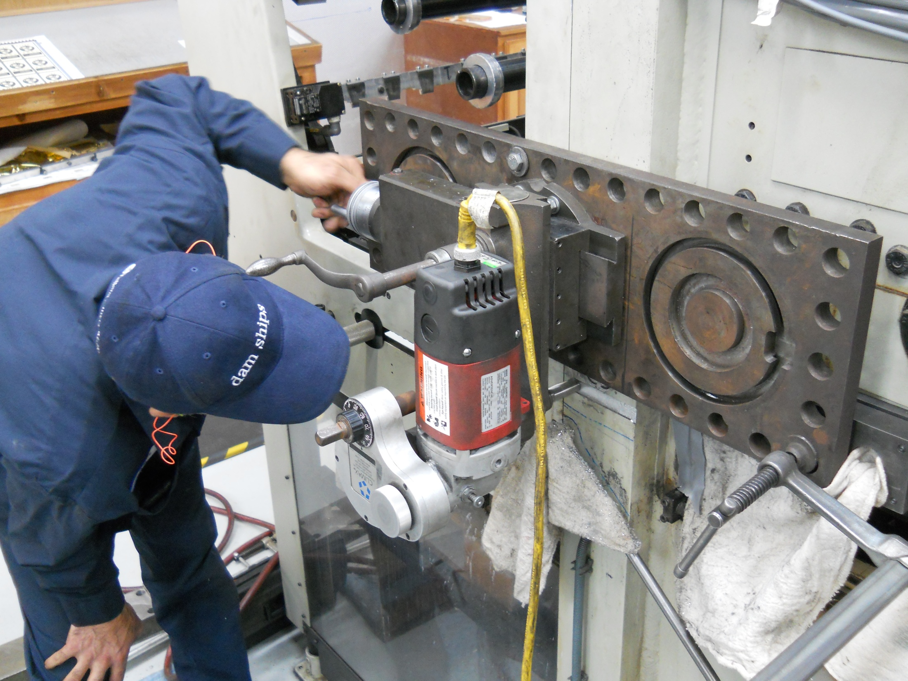
Milling out pocket to accept reinforcement bracket.

Slide 11
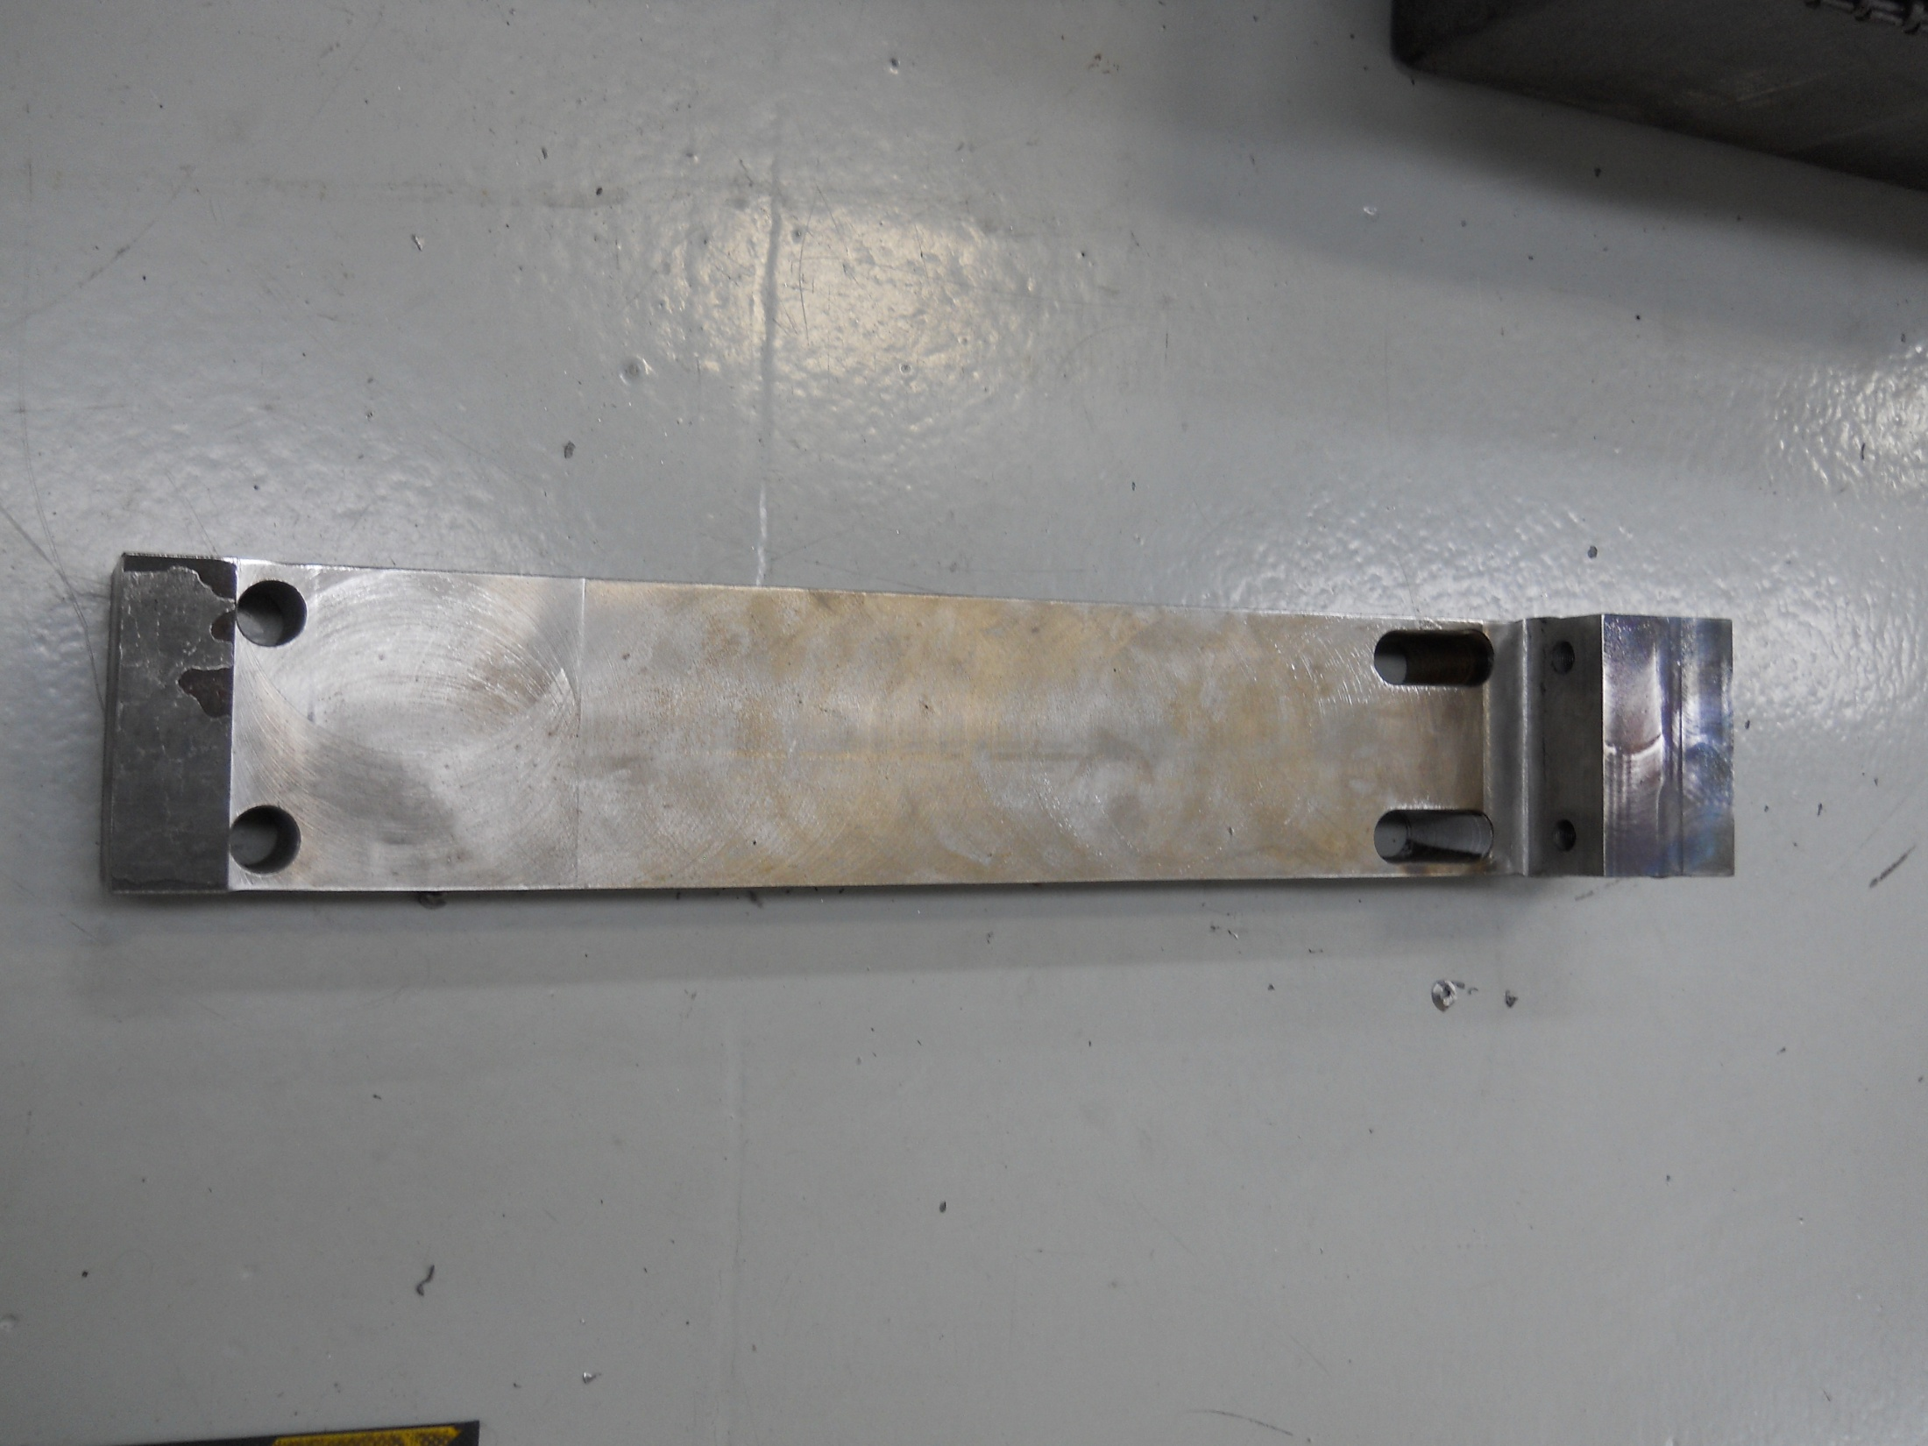
Reinforcement bracket which will be mounted over the side of the frame on the label press. This will insure that the repair will not pull apart. This damaged occurred under normal operating conditions so we are making sure the repair is better then new.

Slide 12
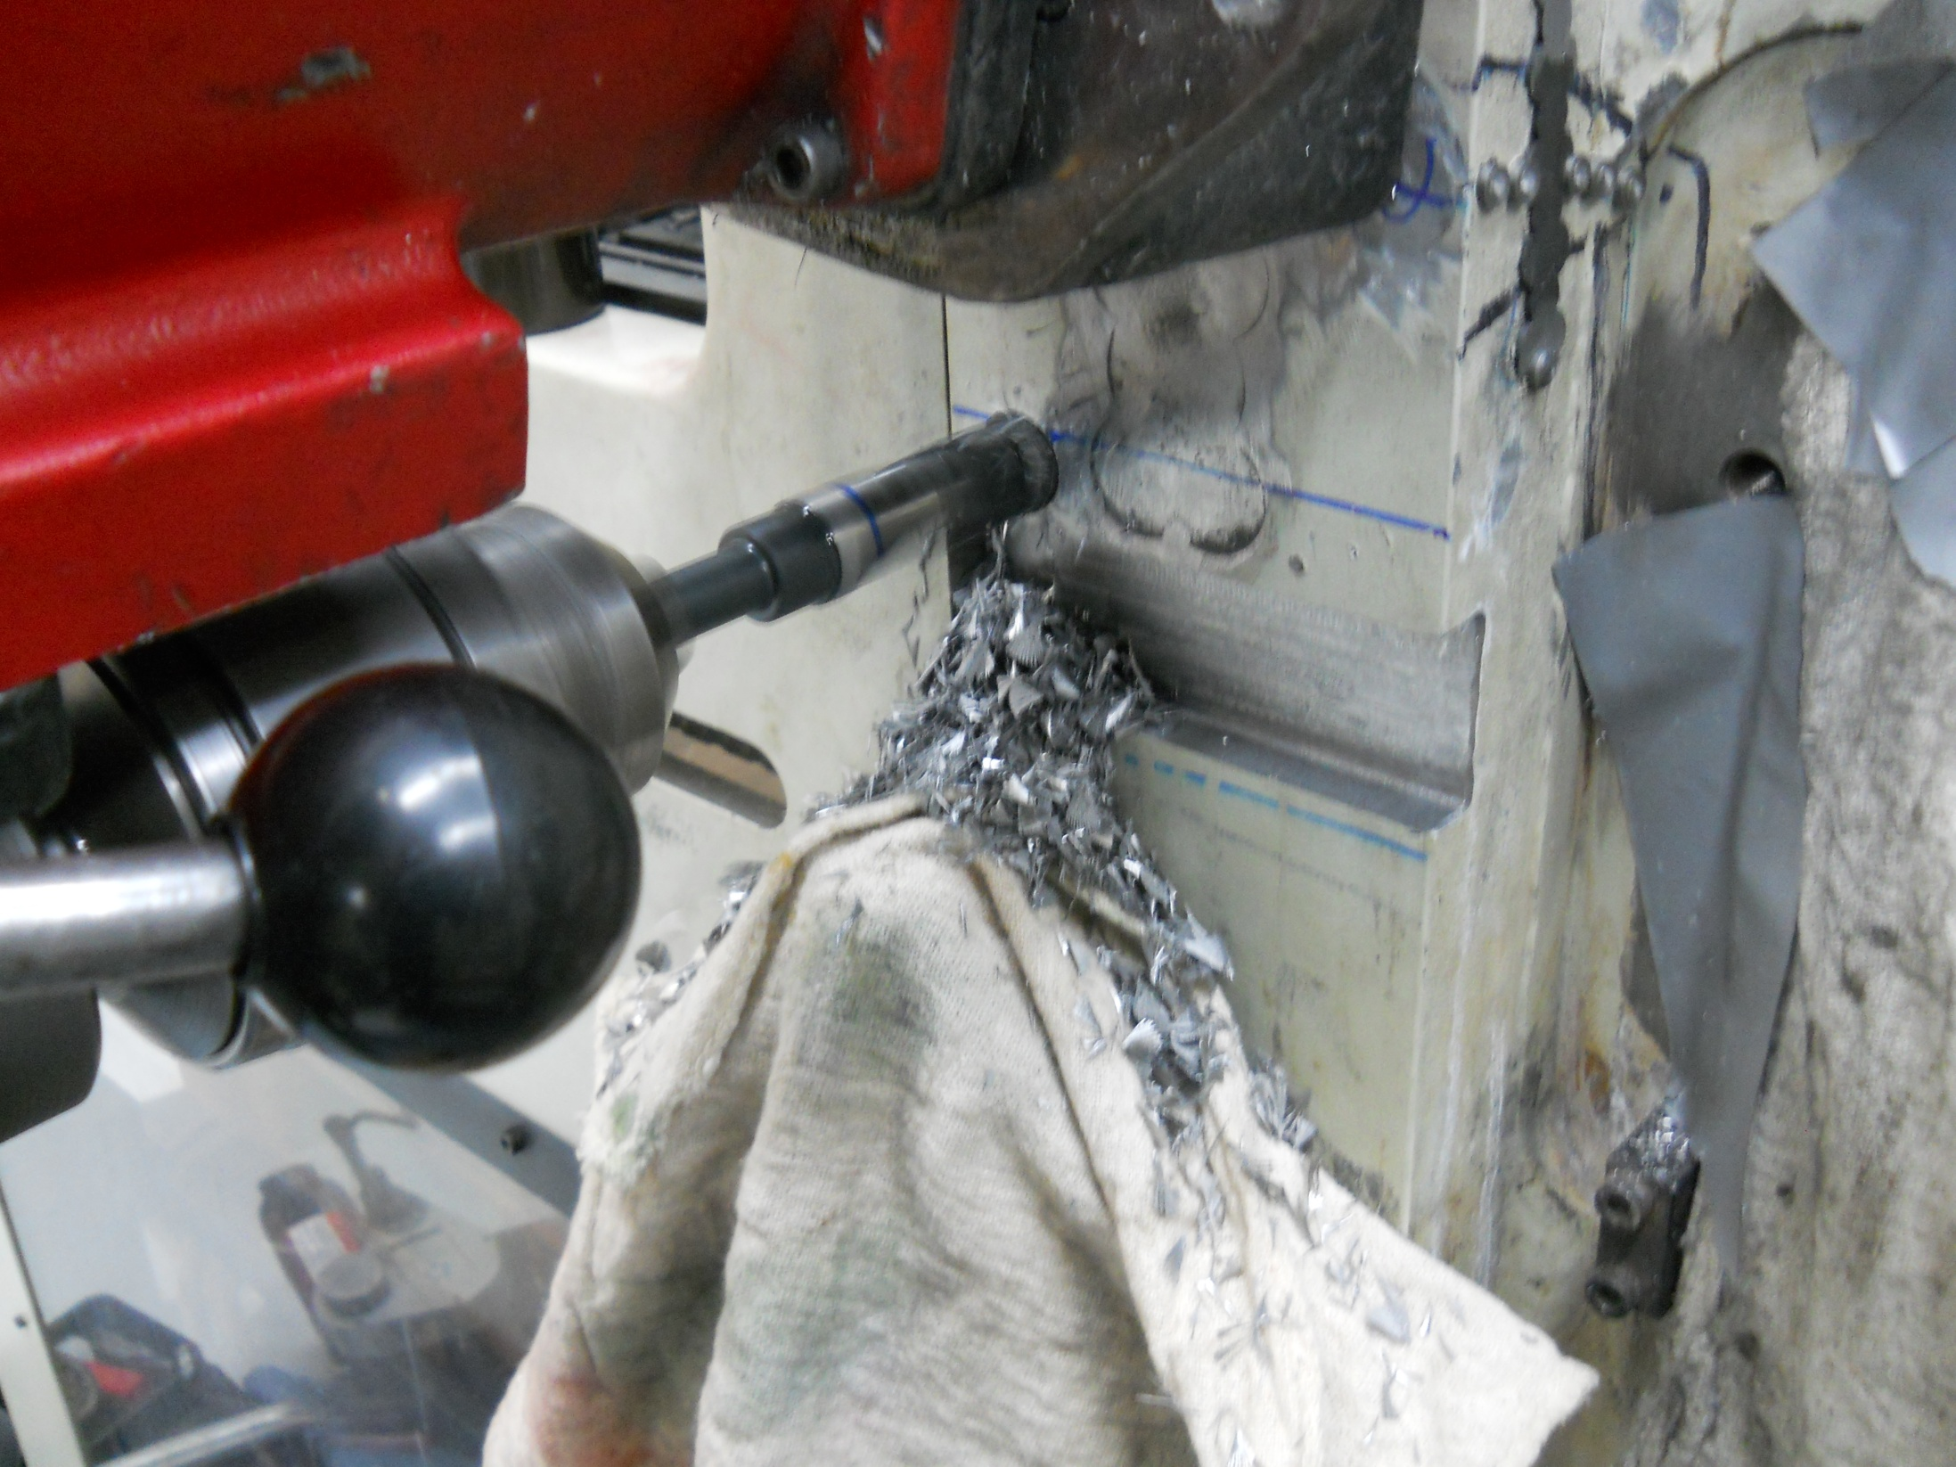
Milling almost complete.

Slide 13
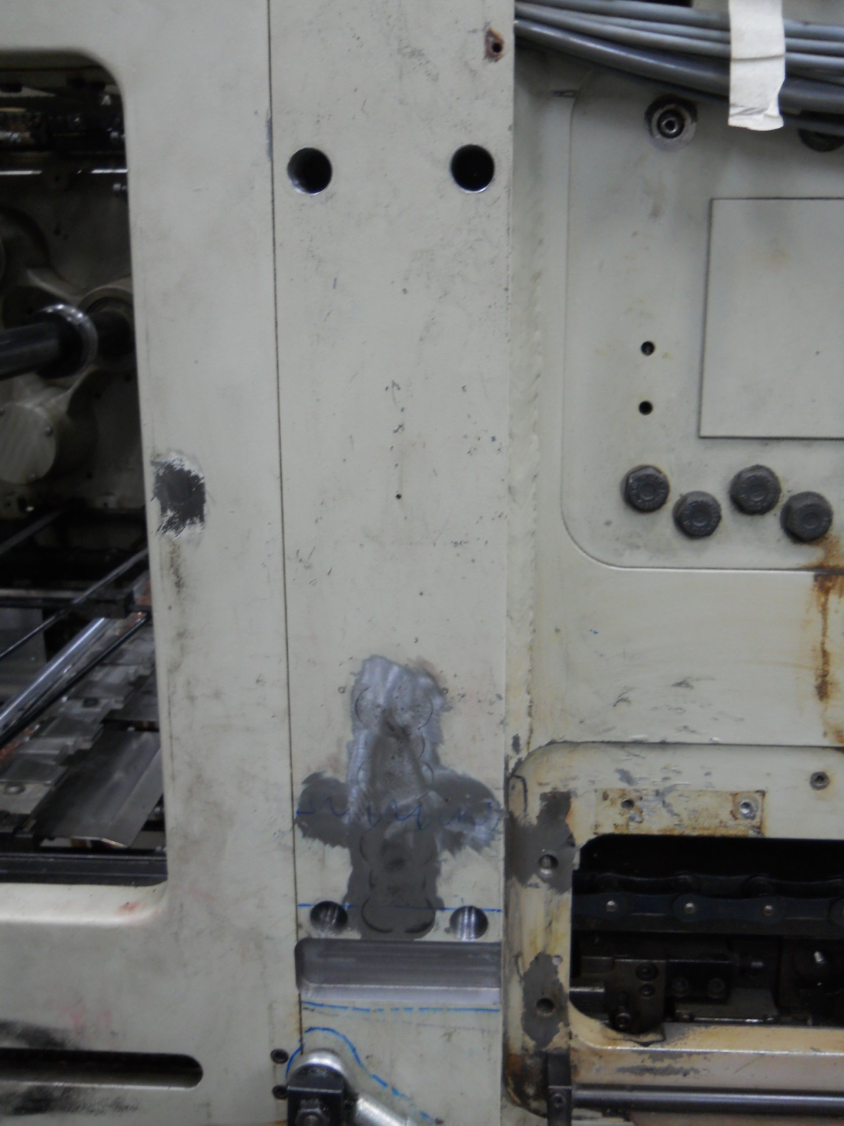
Milling complete and holes drilled to mount reinforcement bracket.

Slide 14
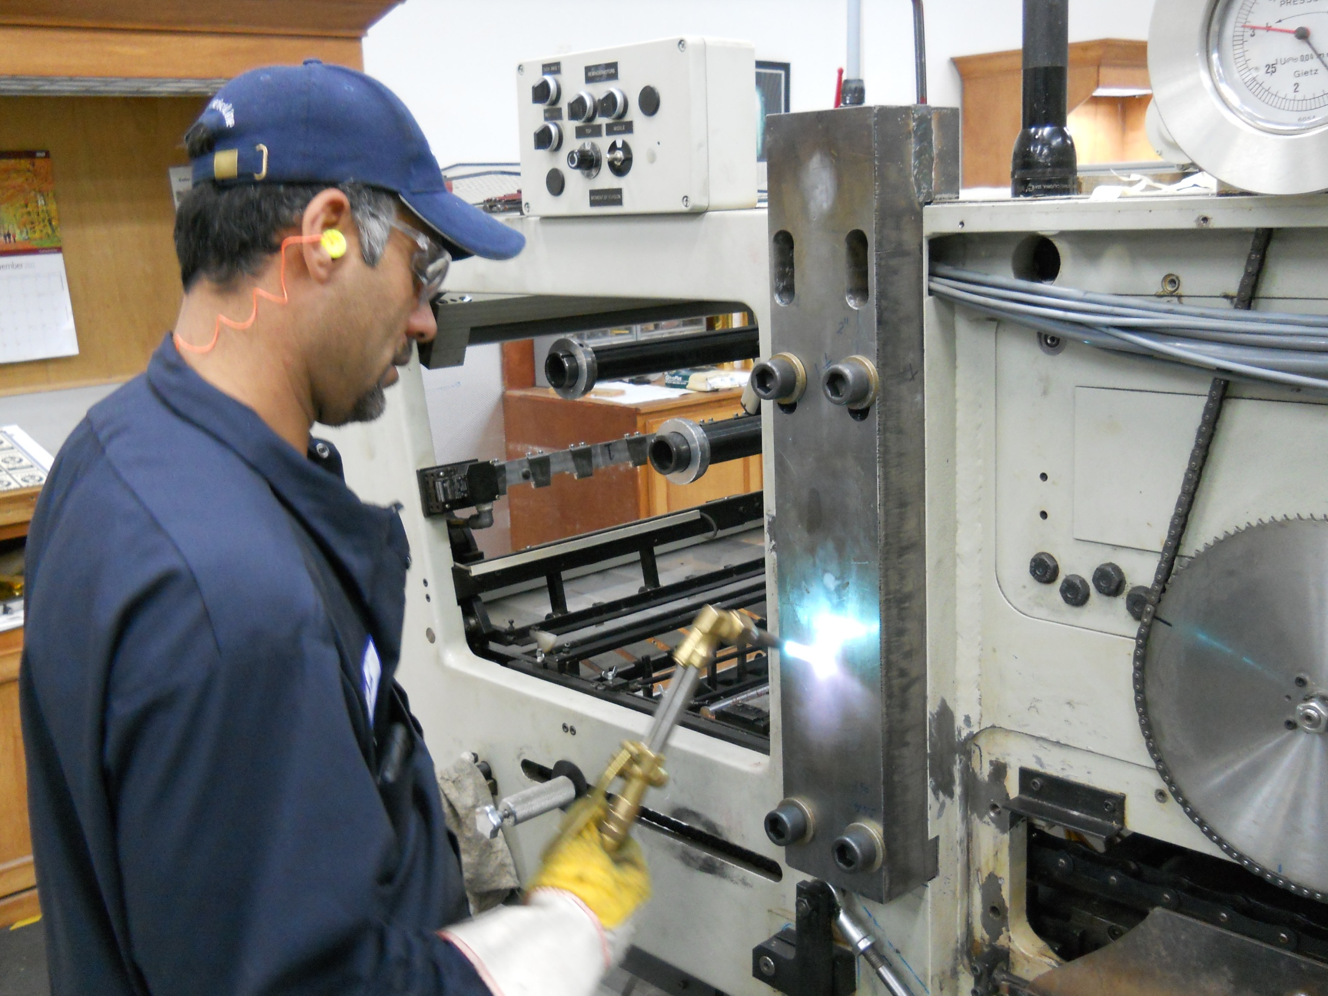
Bracket mounted and the two lower bolts tightened and the heat from the torch will make the bracket shrink. Then all bolts will be tightened and when the bracket cools it will be that much stronger.

Slide 15
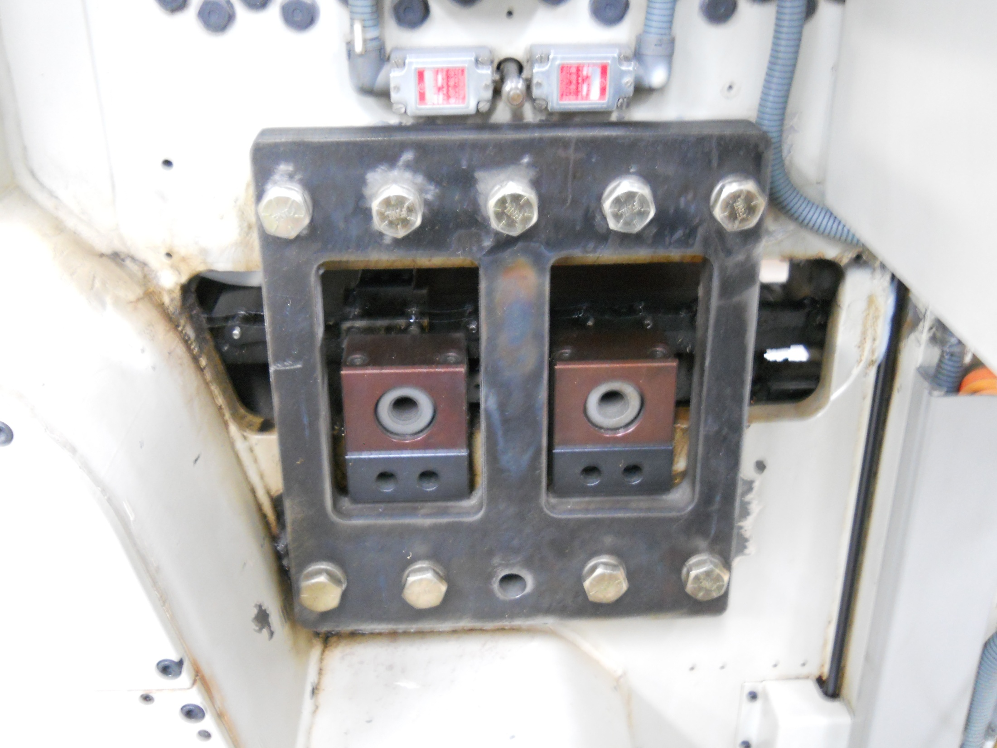
Bracket mounted on outside of printing press to insure additional strength.

Slide 16
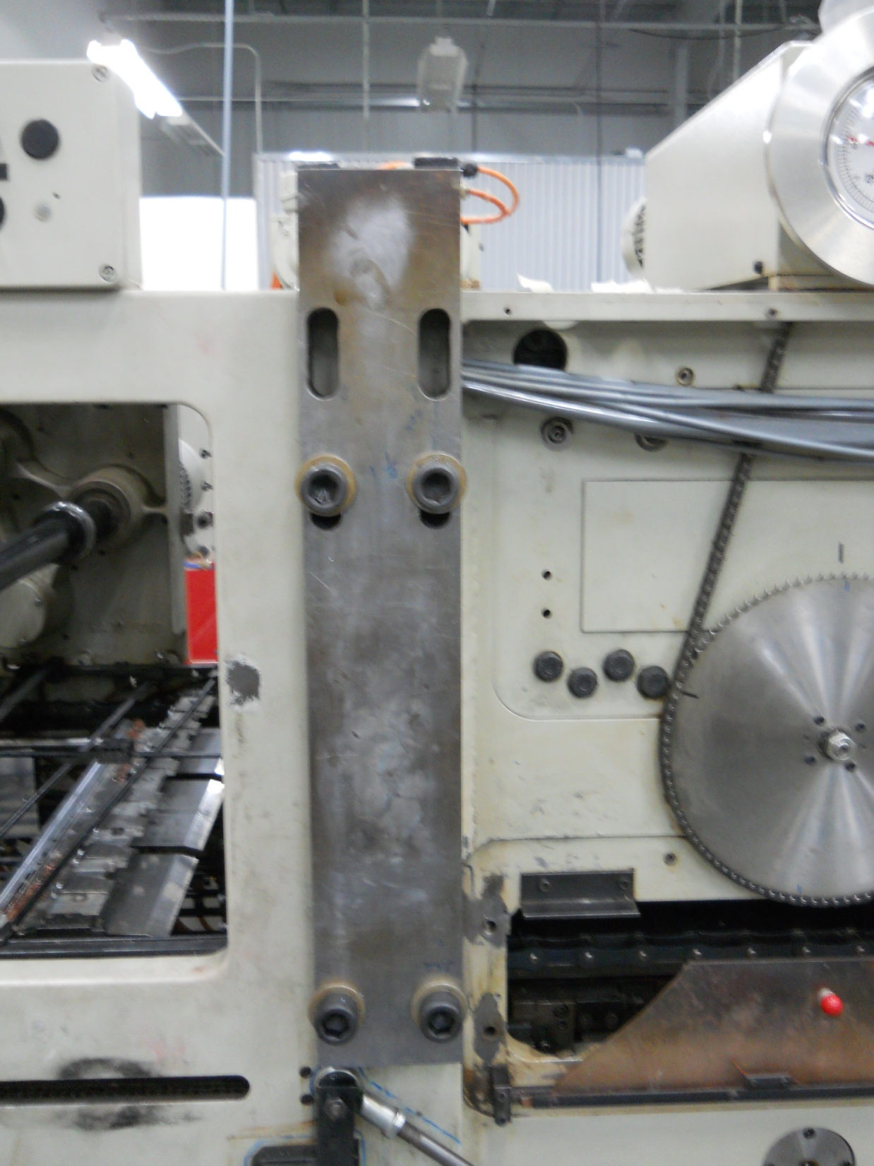
Repair completed and ready to be put back into production.

