Slide 1
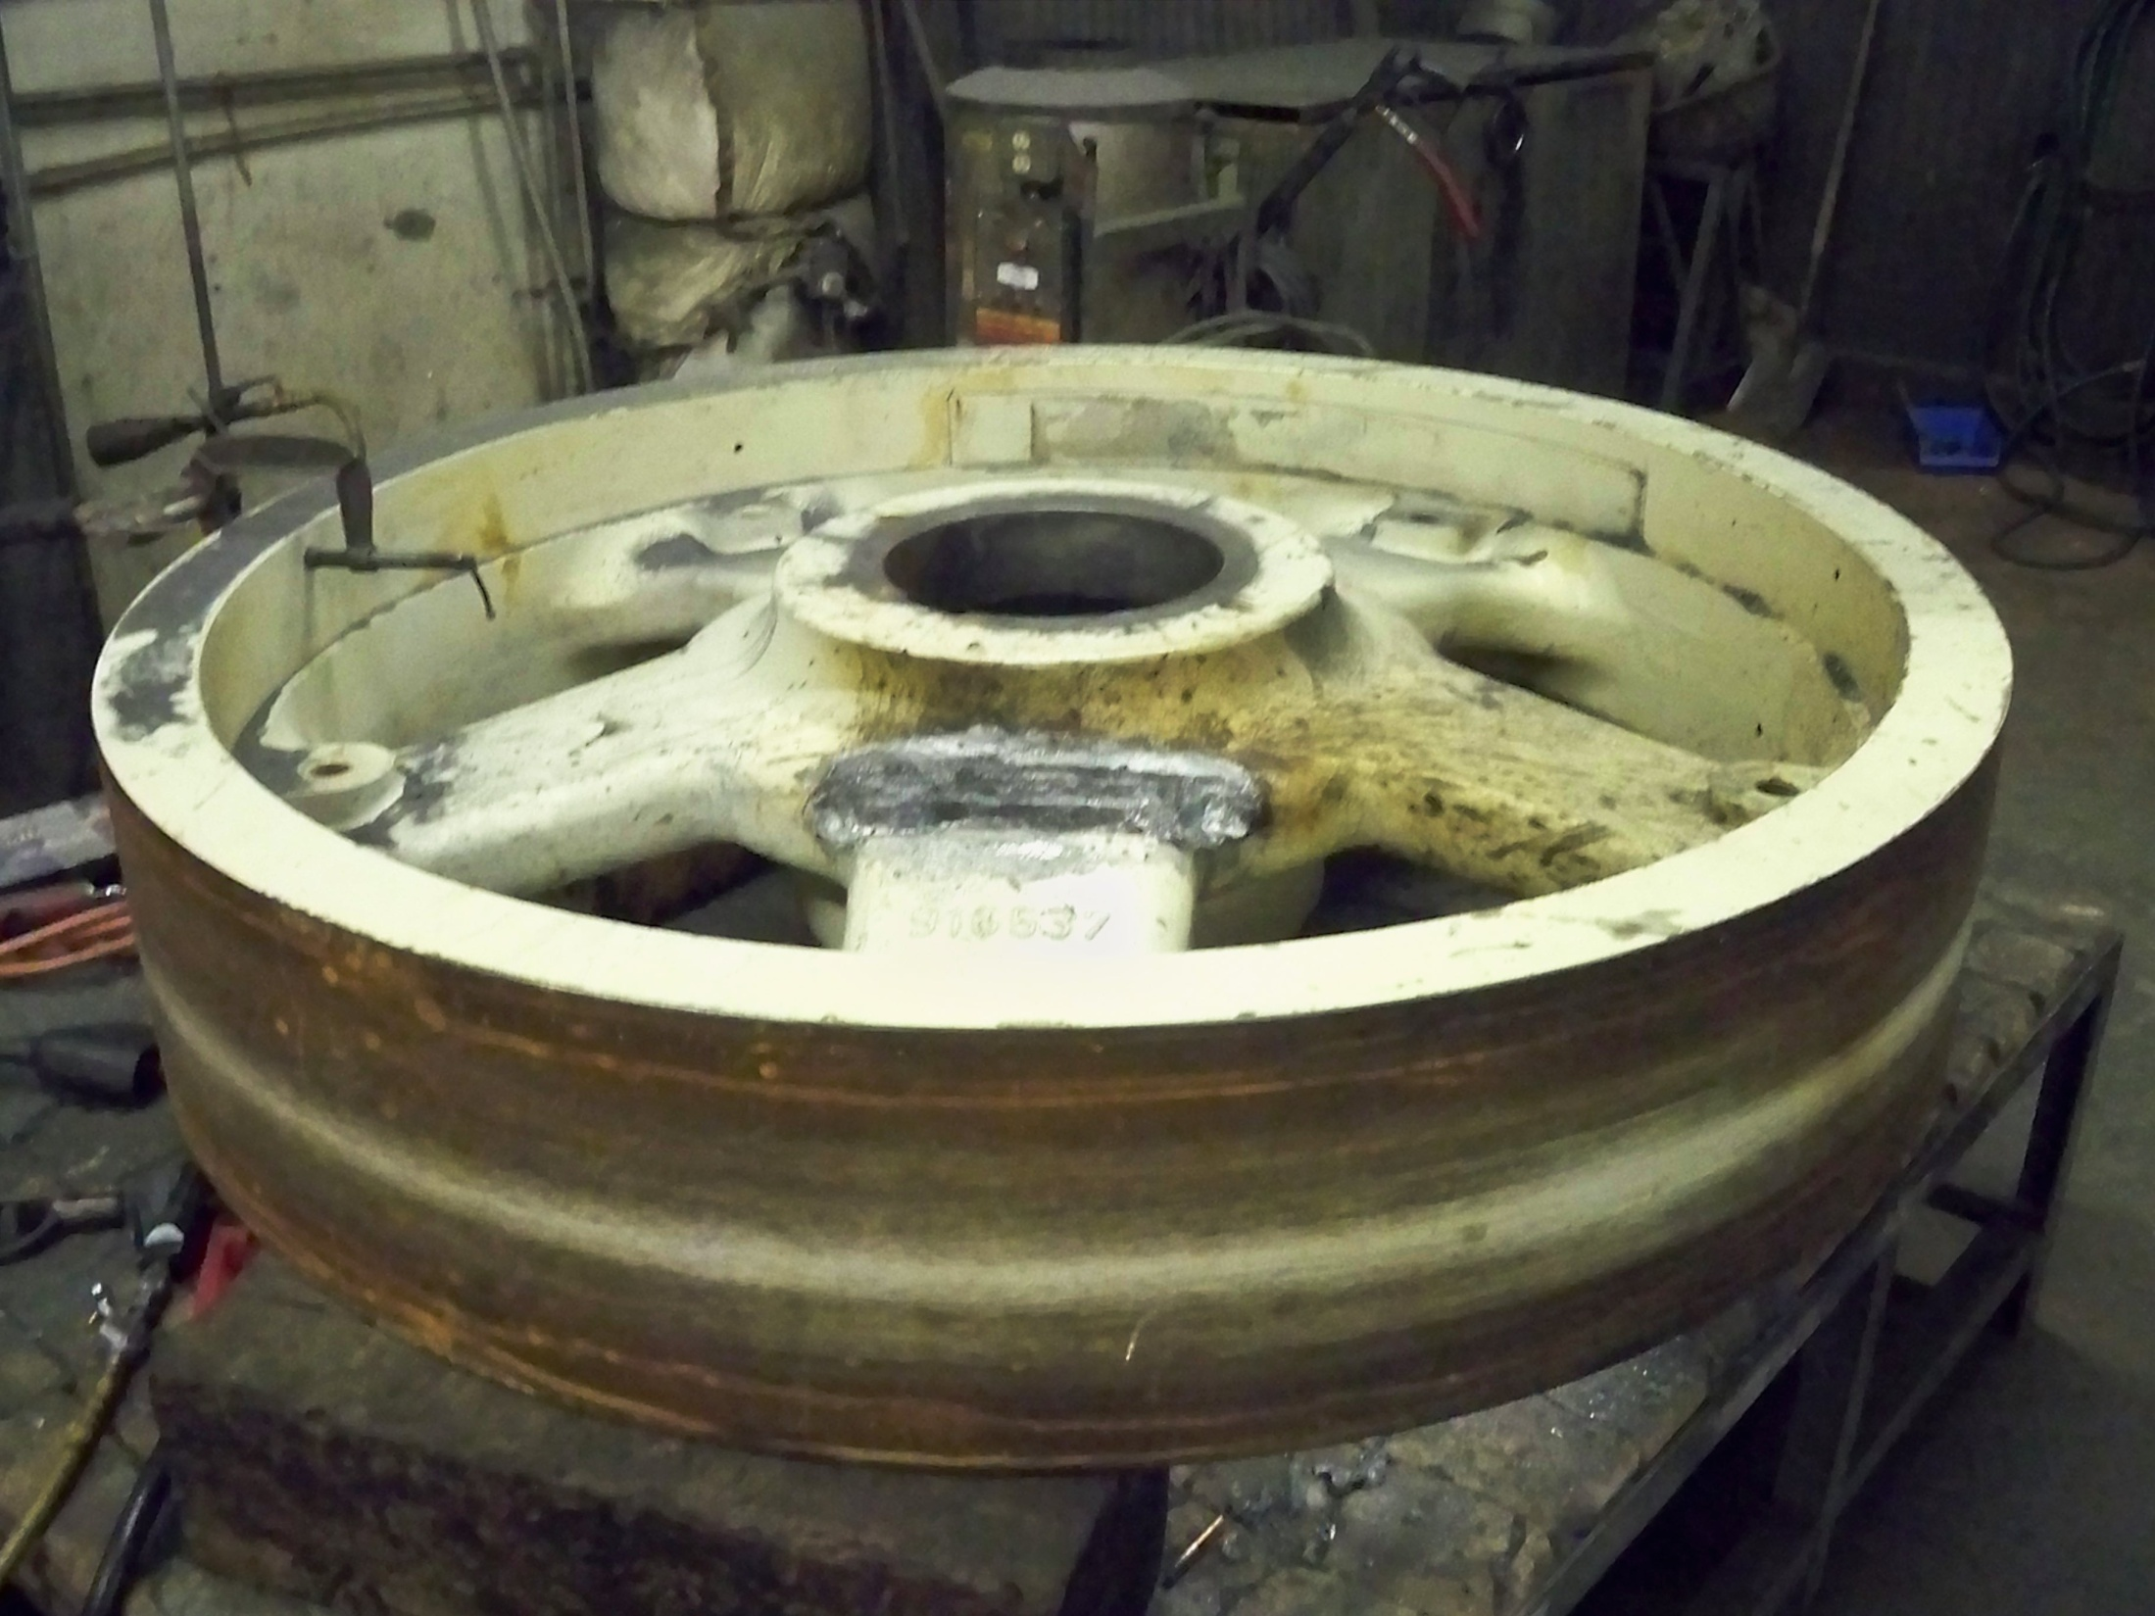

Slide 2
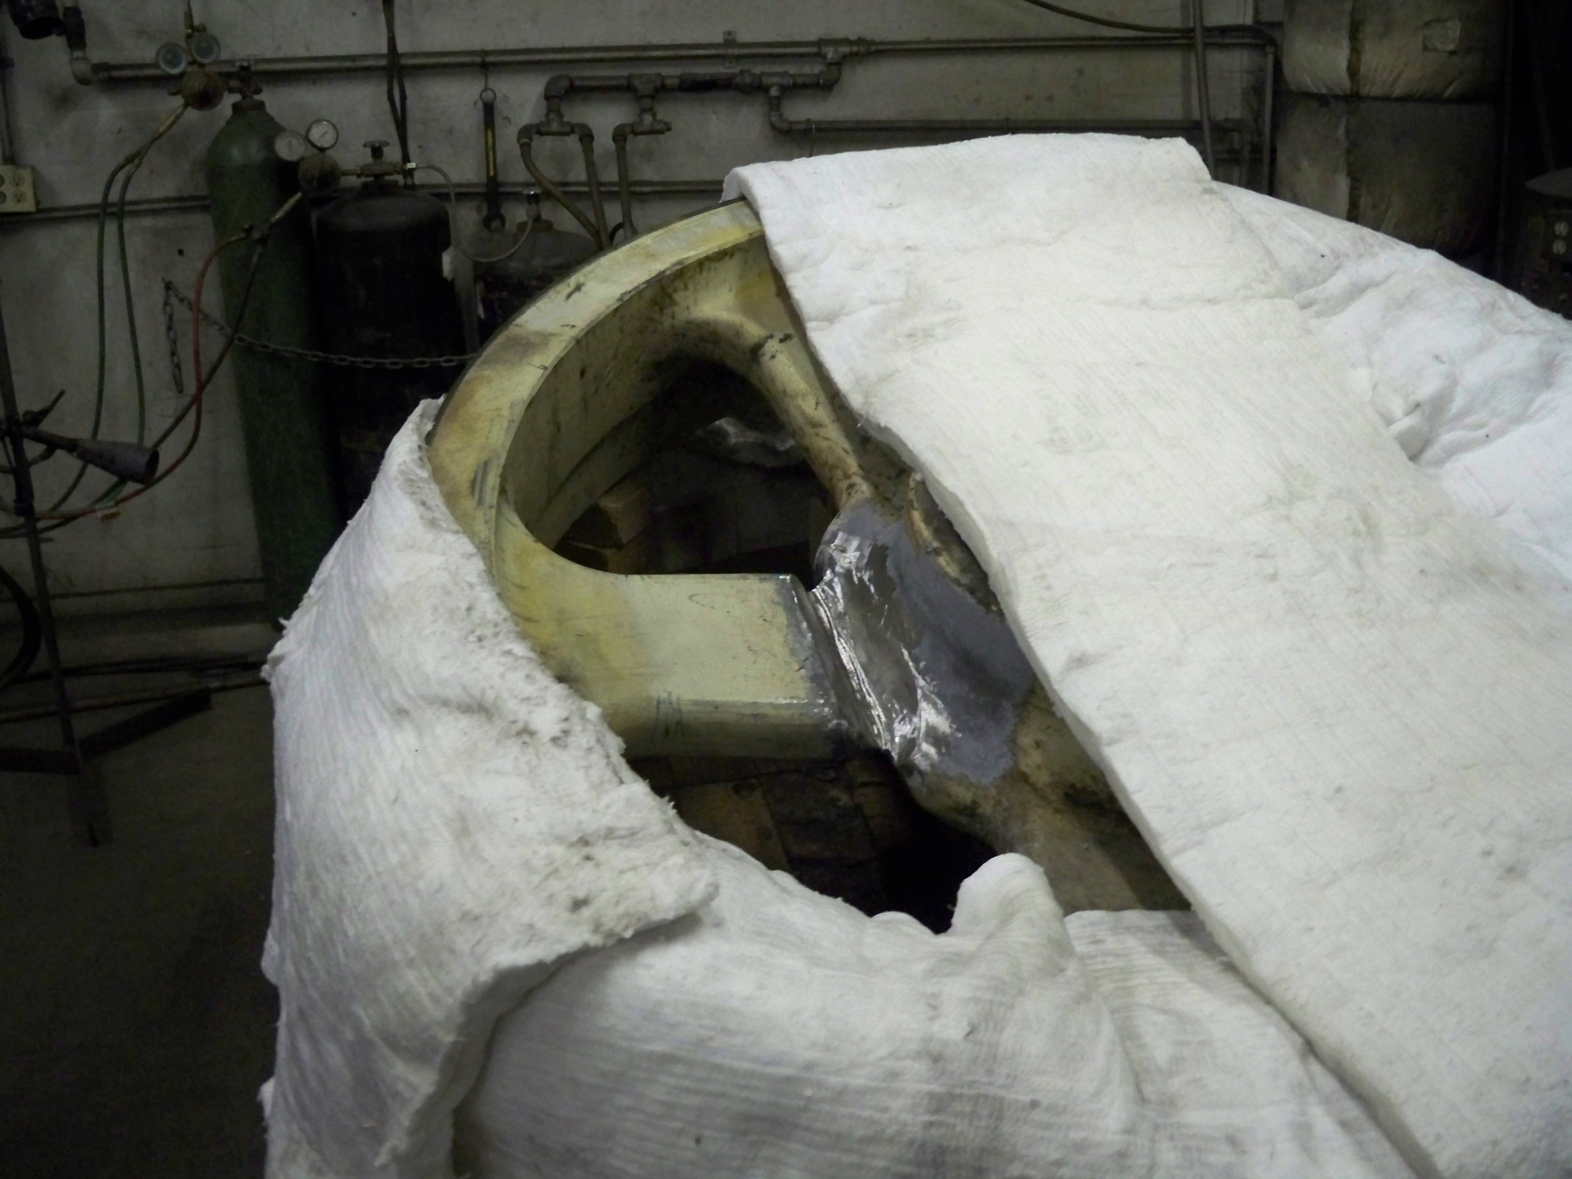
Damaged area ground out ready to be furnace brazed.

Slide 3
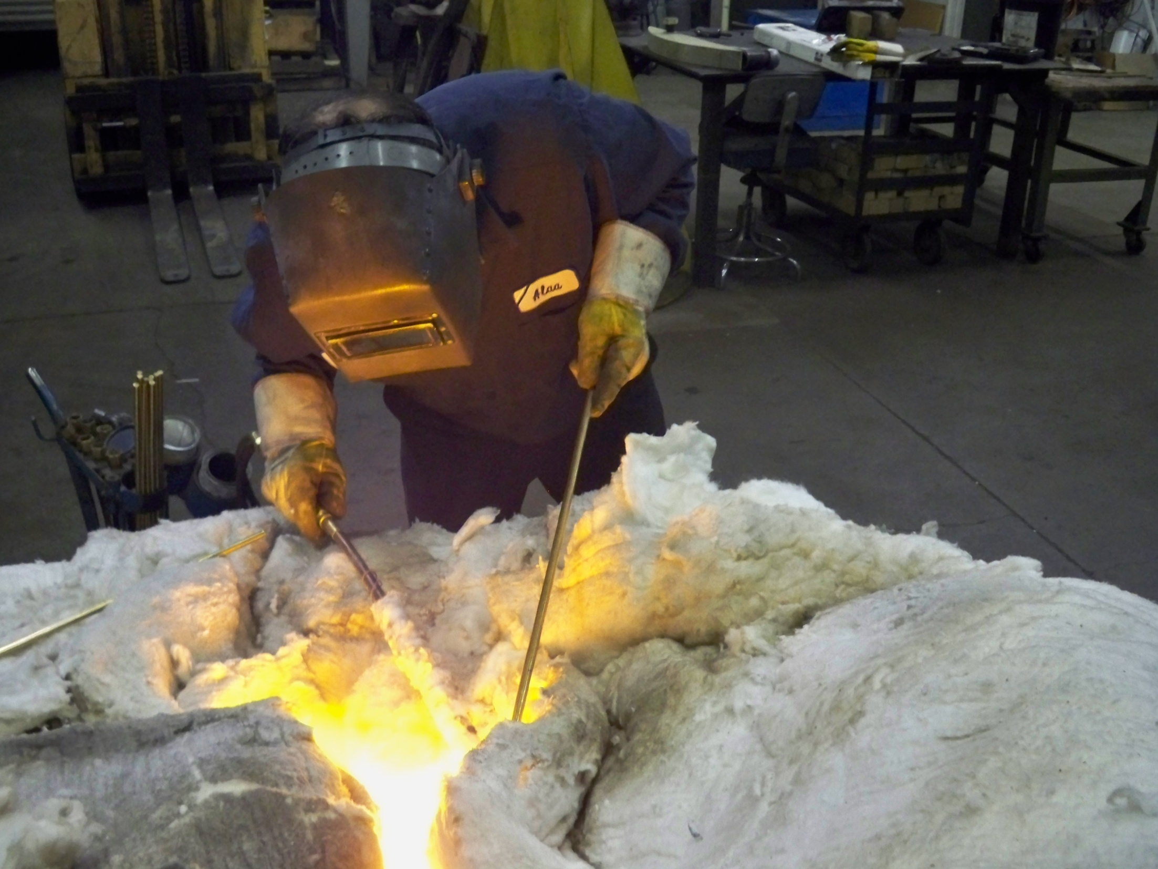
Furnace brazing requires 1,000 degrees pre heat and then a slow cool down period.

Slide 4
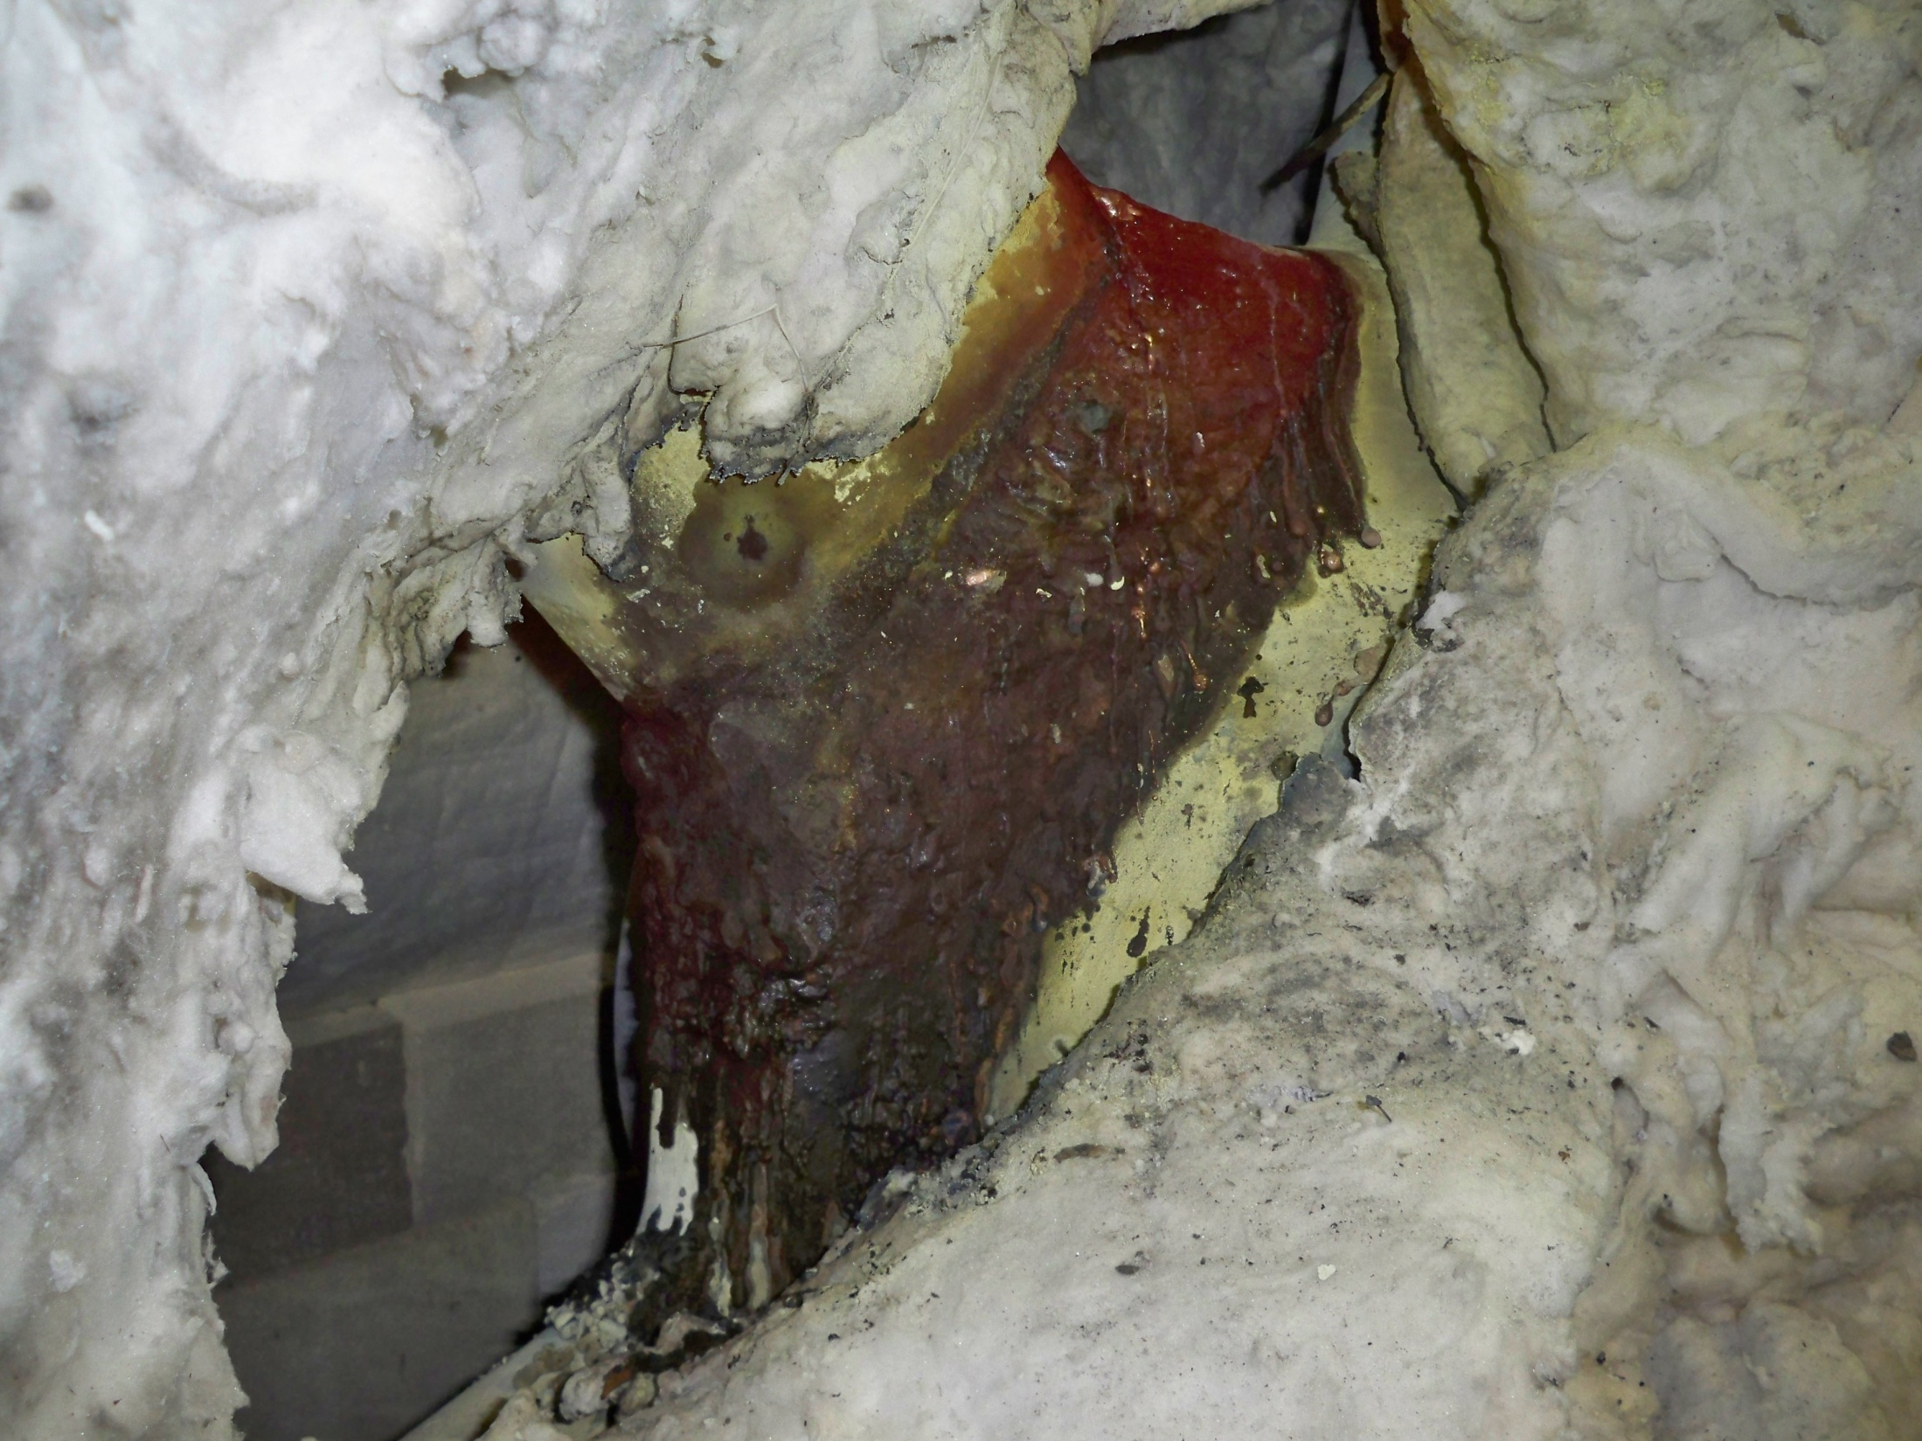
Furnace brazing completed and slow cooling.

Slide 5
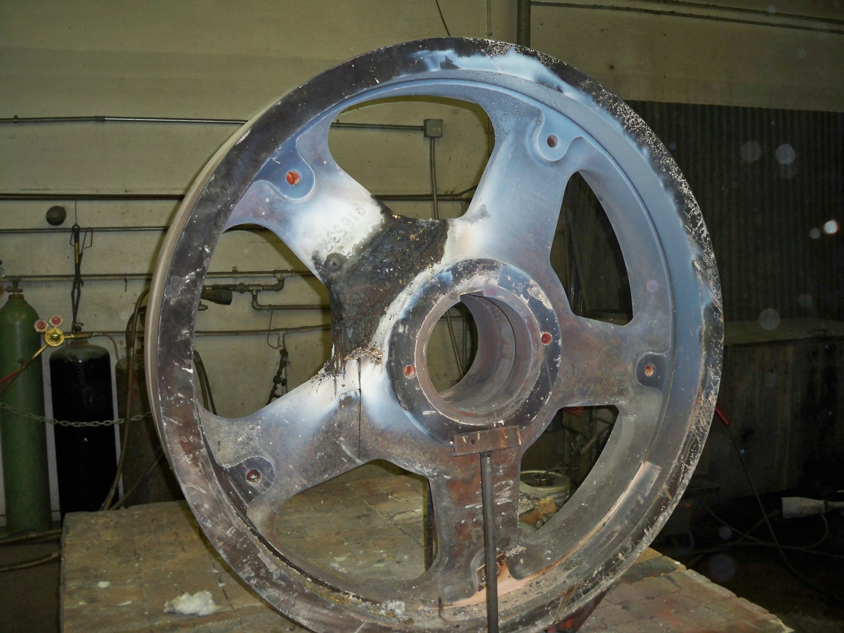
Ready to hand finish

Slide 6
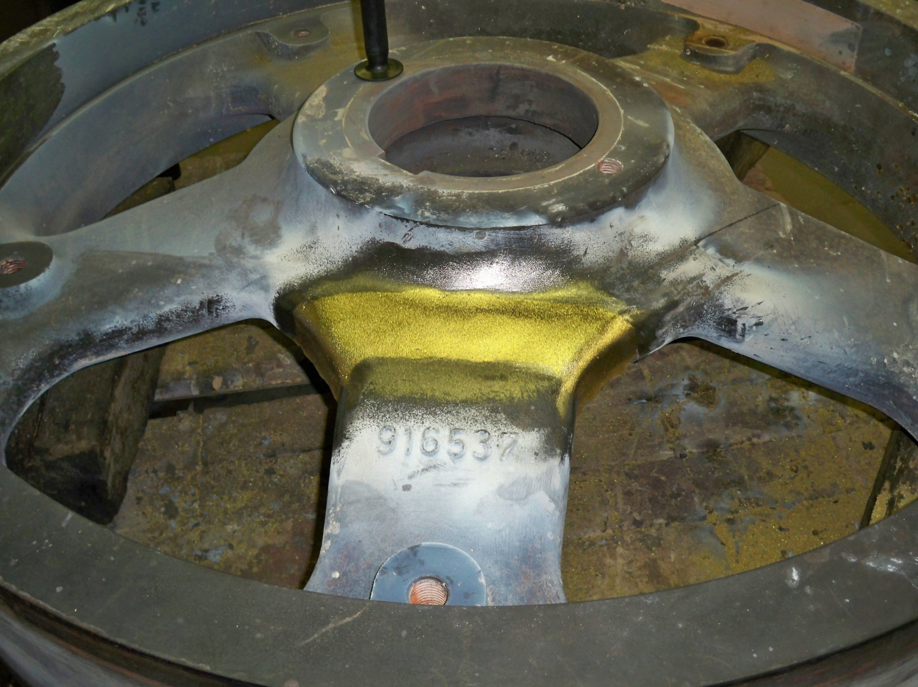
Hand finished and ready to be painted

Slide 7
