Slide 1
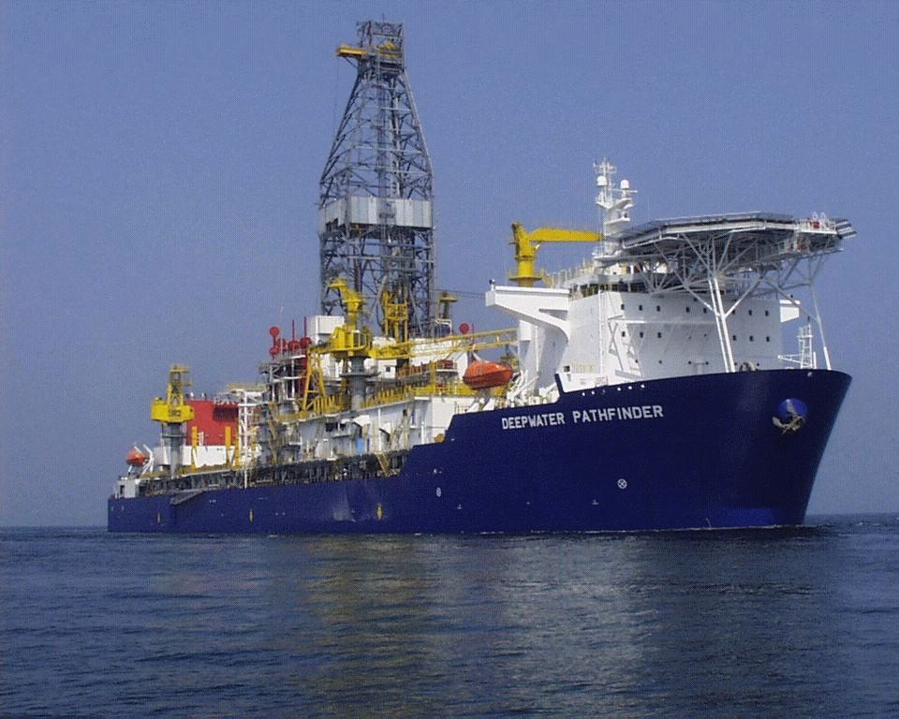
Deepwater Pathfinder
Repair completed by LOCK-N-STITCH Inc.
September 2012

Slide 2
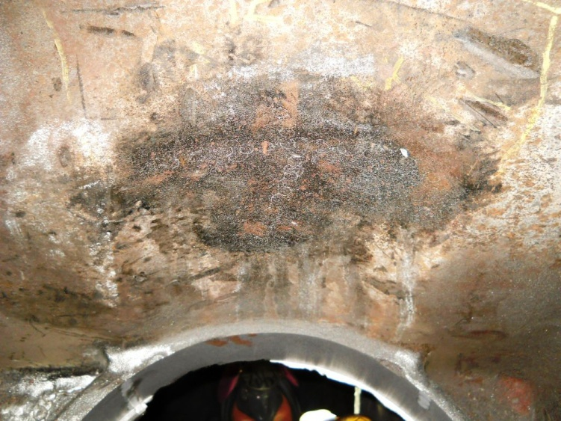
Water jacket to air box crack completed

Slide 3
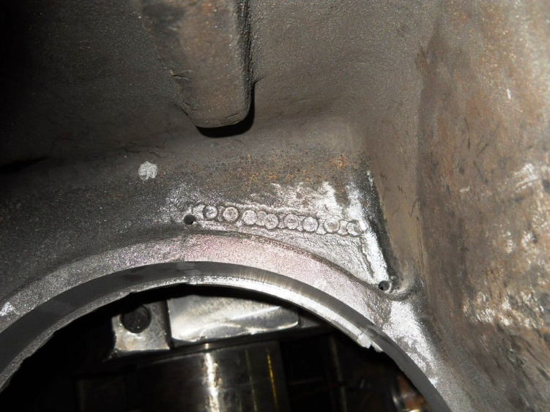
Lower bore repair side A2 needs two more pins and finish work

Slide 4
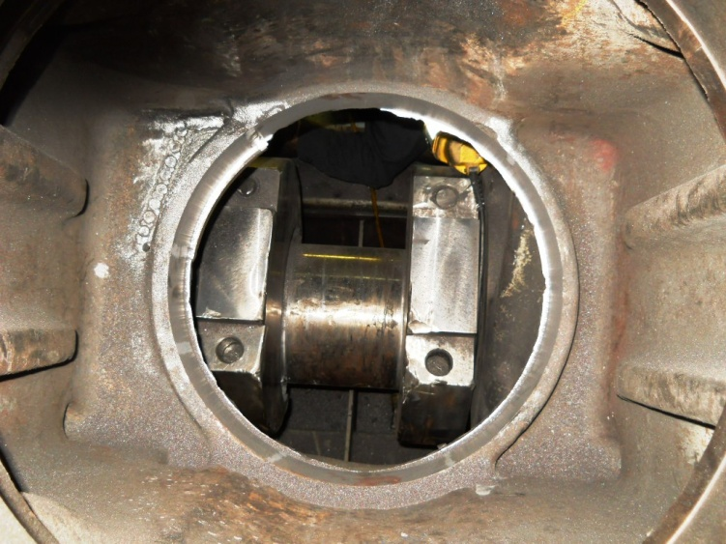
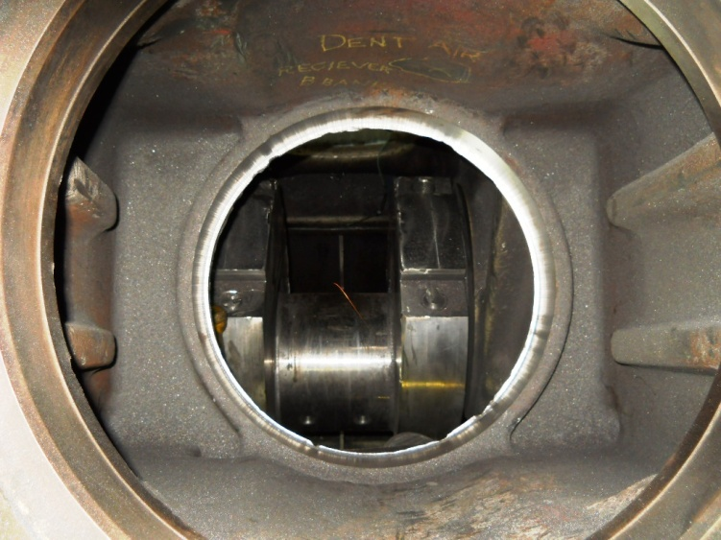
Bores A2 and B2 are bored and ready to accept repair sleeves

Slide 5
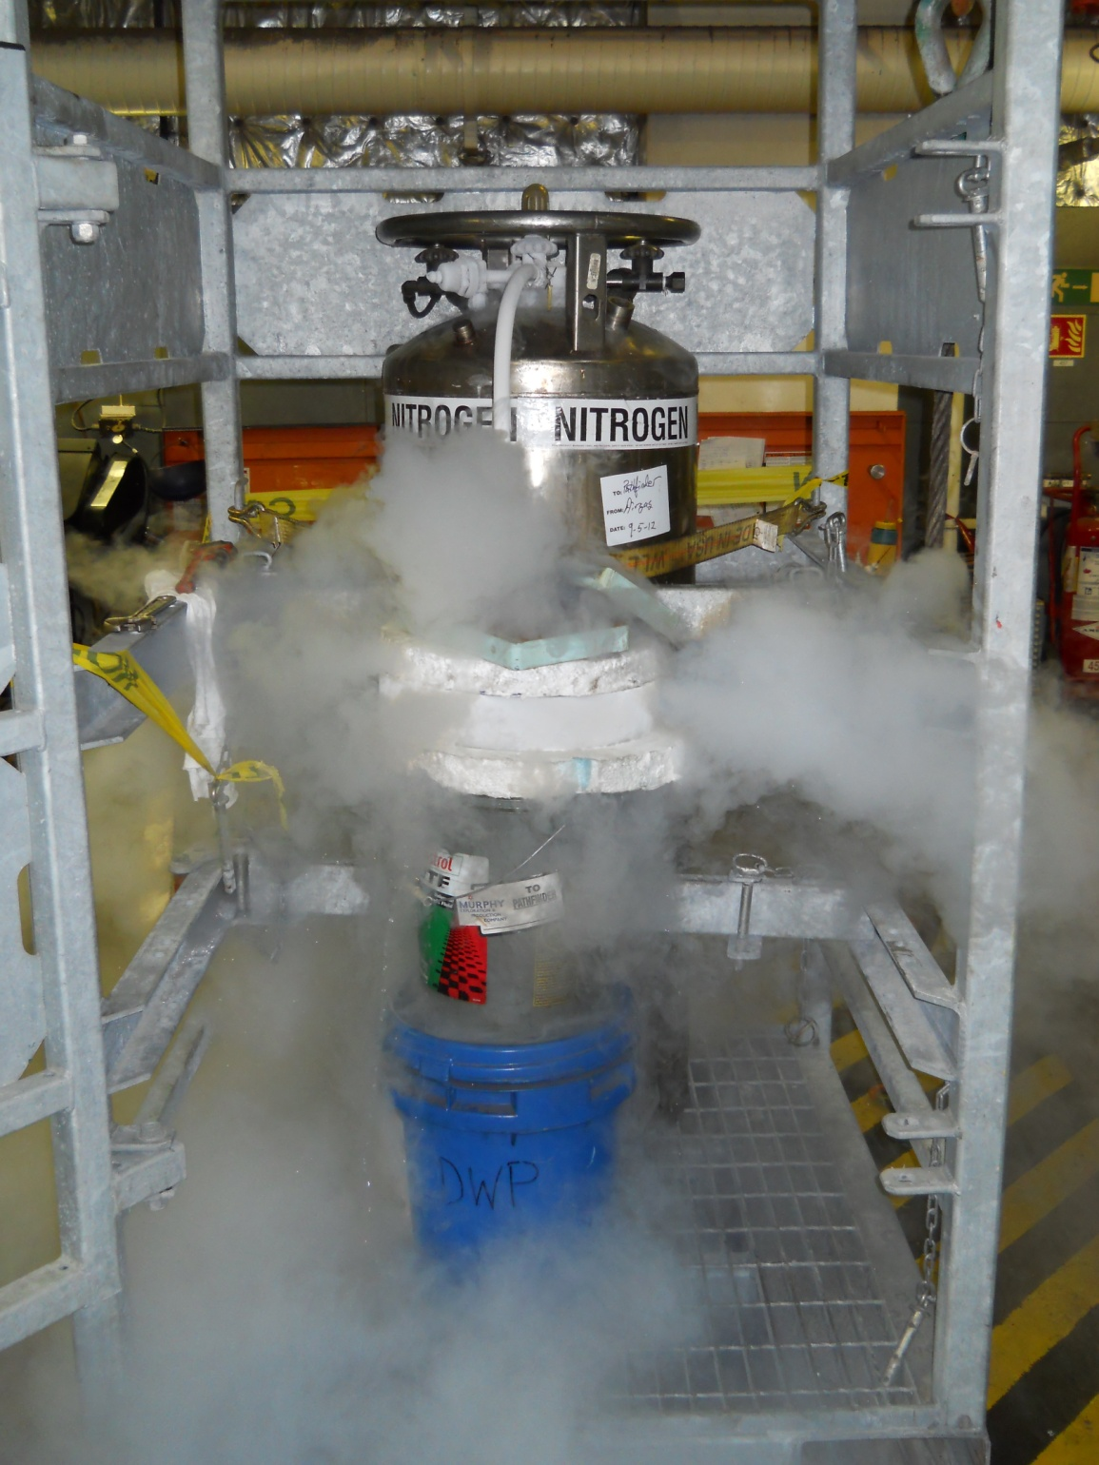
Using liquid Nitrogen to shrink the repair sleeve for the lower bores

Slide 6
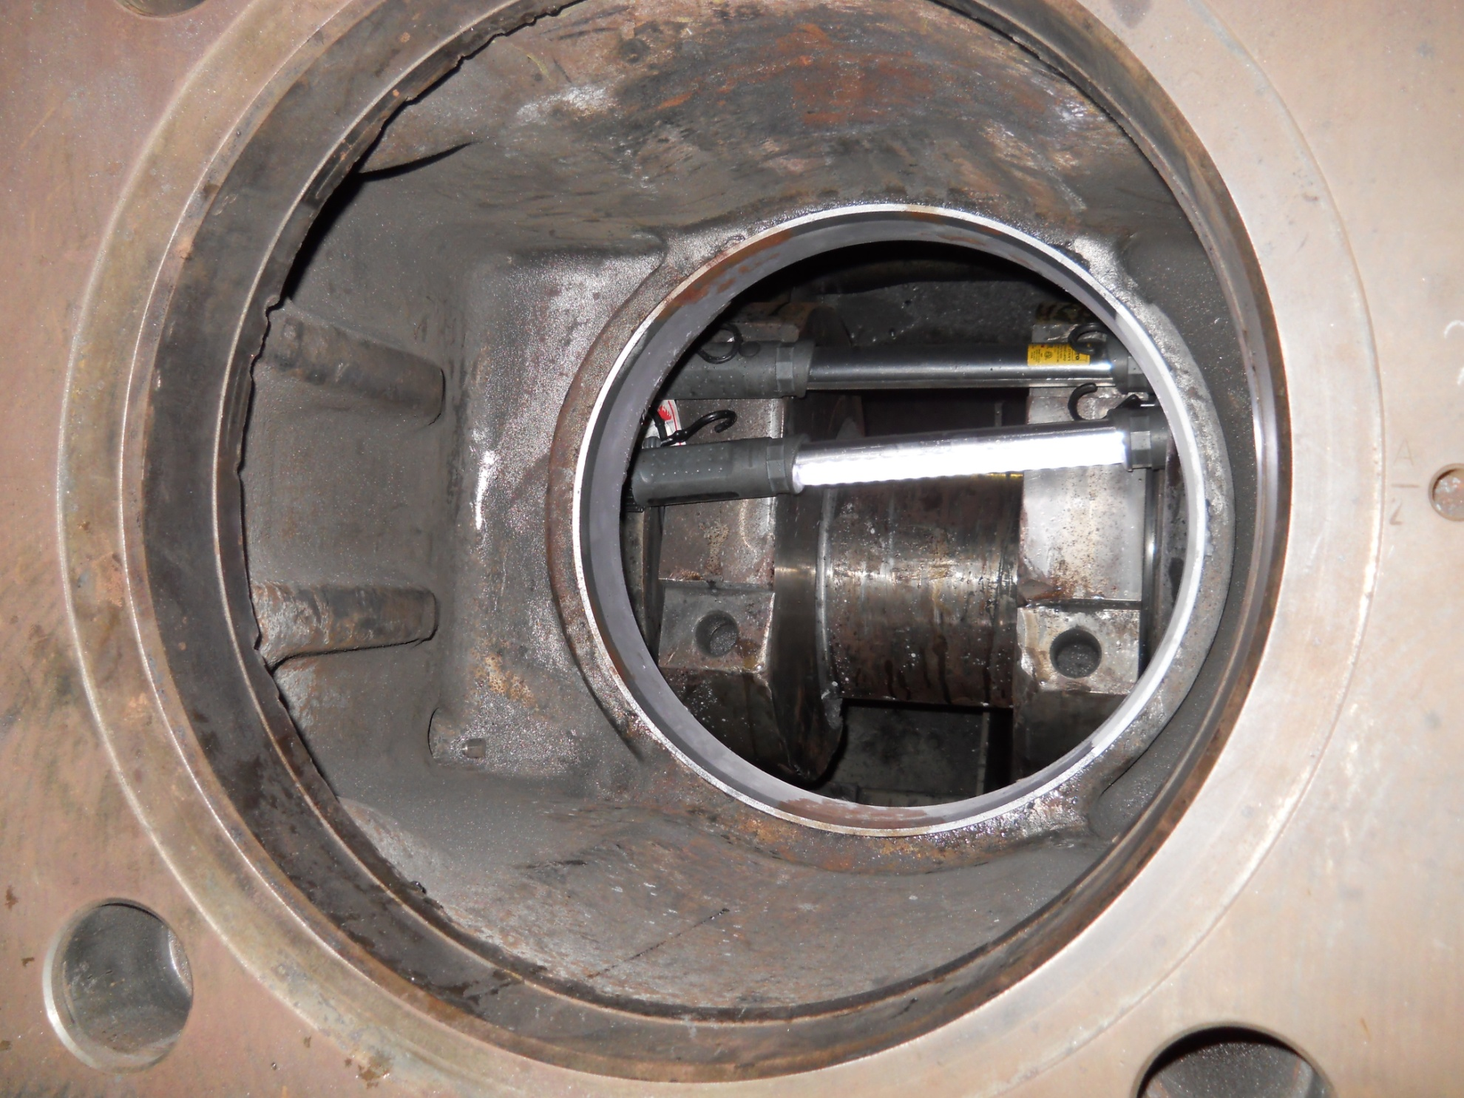
Lower bore repair sleeve installed and ready for final machining

Slide 7
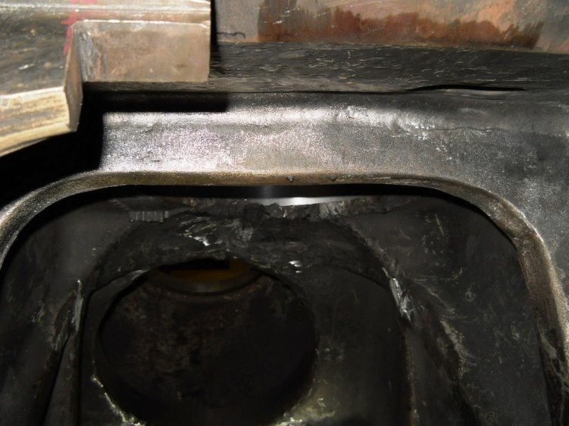
Stiffening bracket side A2 completed

Slide 8
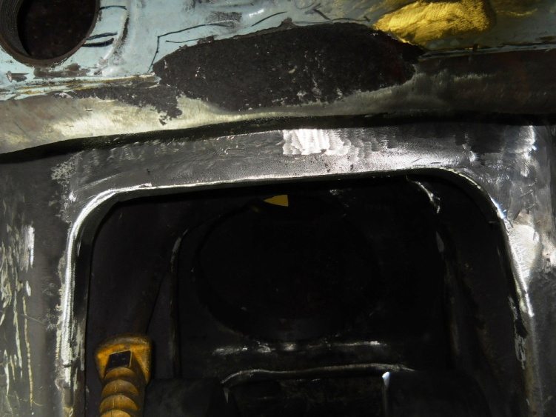
Stiffening bracket side B2 is stitched and ready for finish work

Slide 9
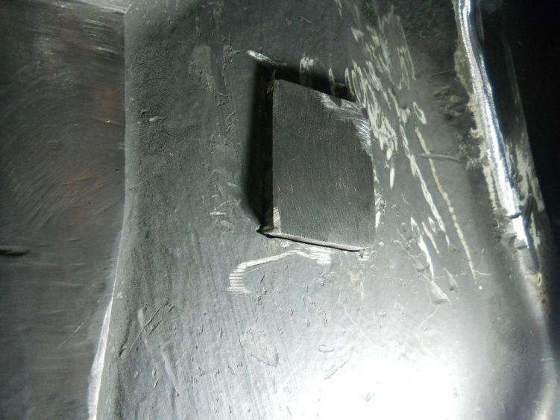
Side B2 main bearing web damage removed and ready to be stitched

Slide 10
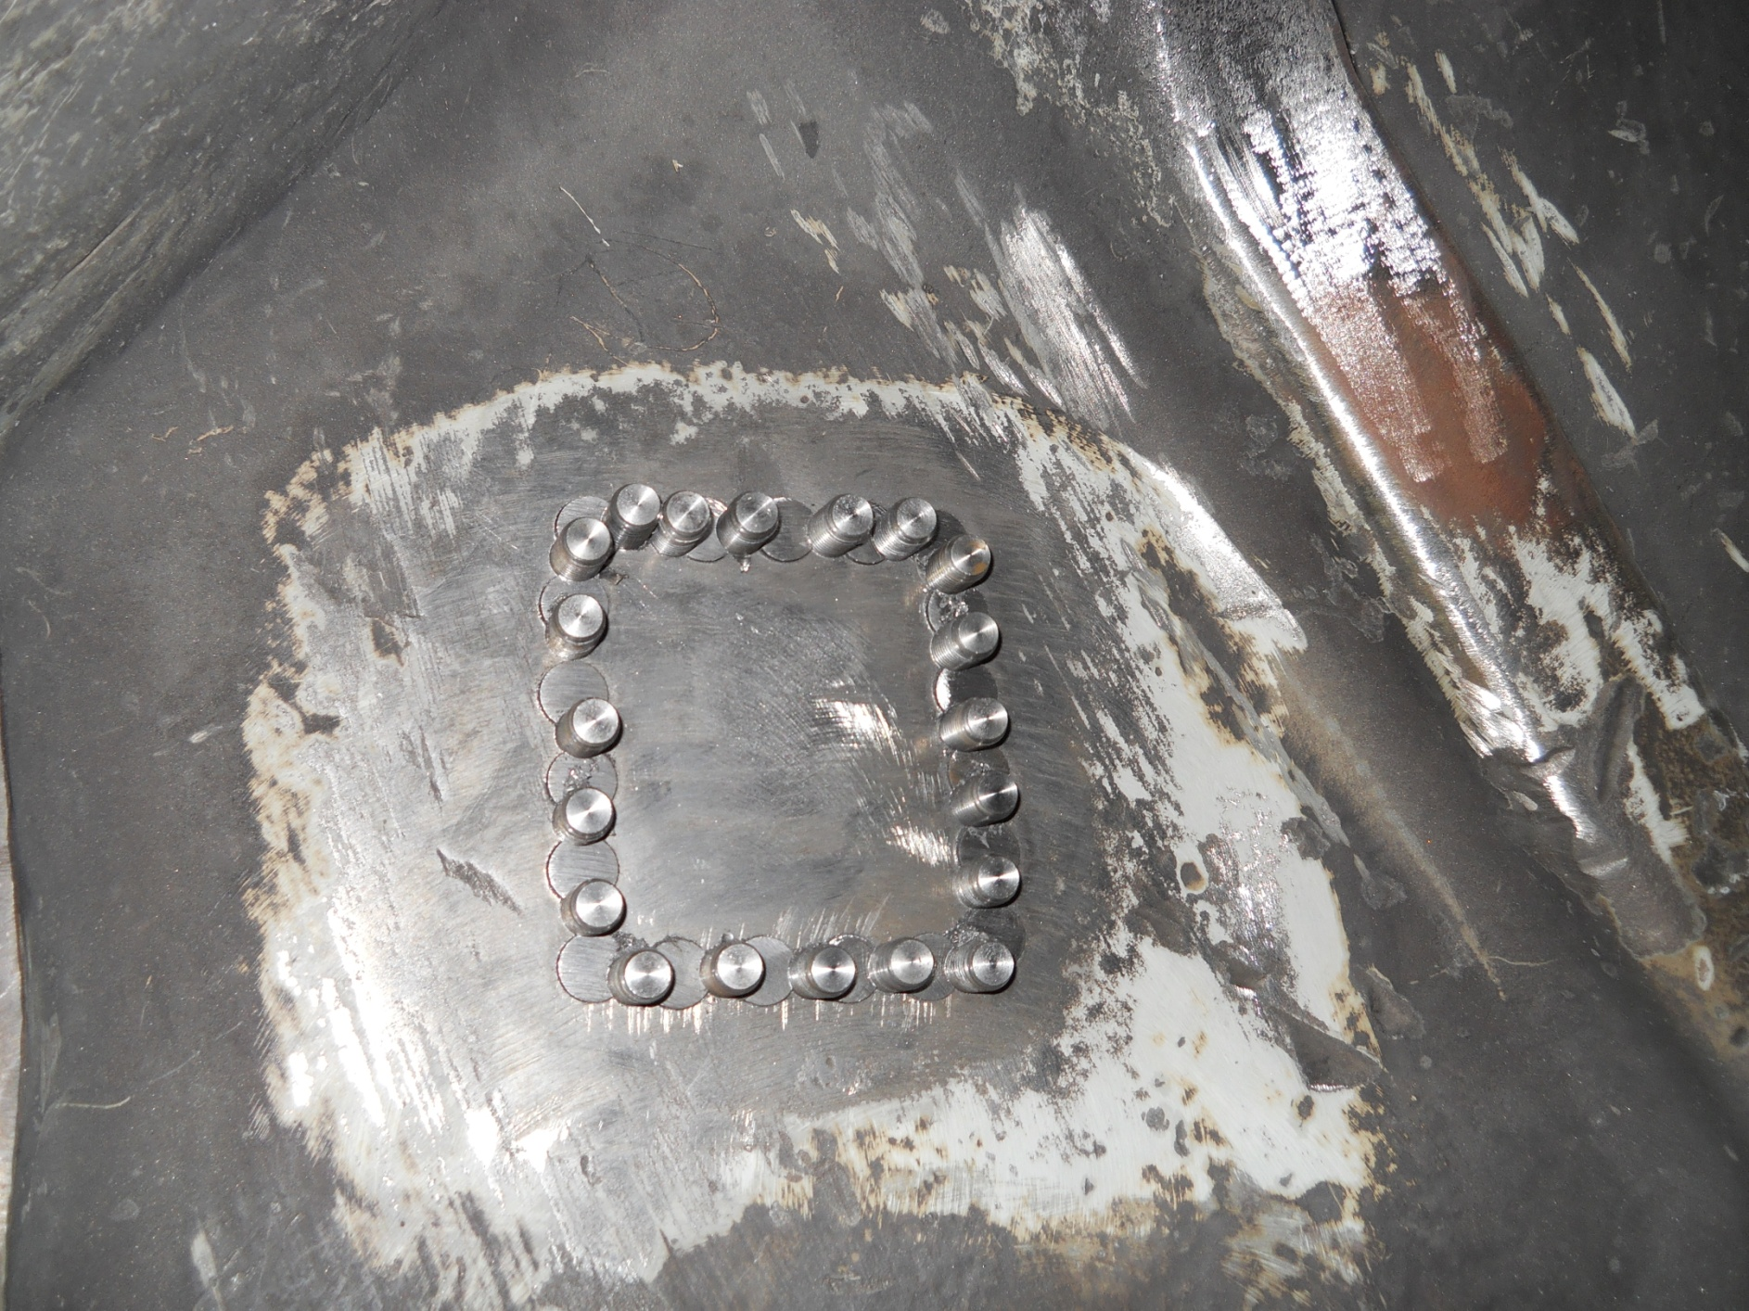
B Side Main Bearing Wall damage casting metal stitching completed and ready to be hand finished

Slide 11
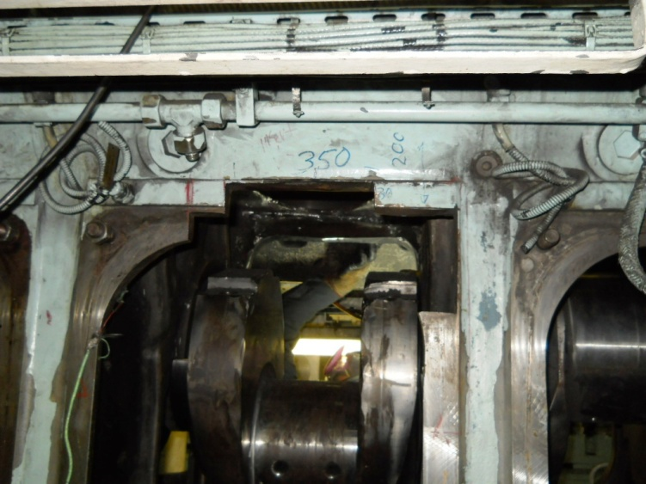
Inspection door side A2 damaged cut out and ready for new casting

Slide 12
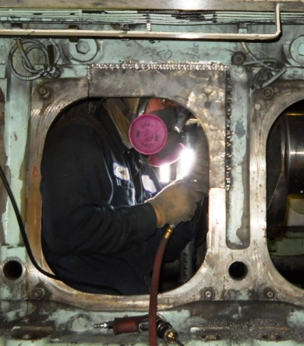
A Side Inspection gasket surface stitched into place

Slide 13
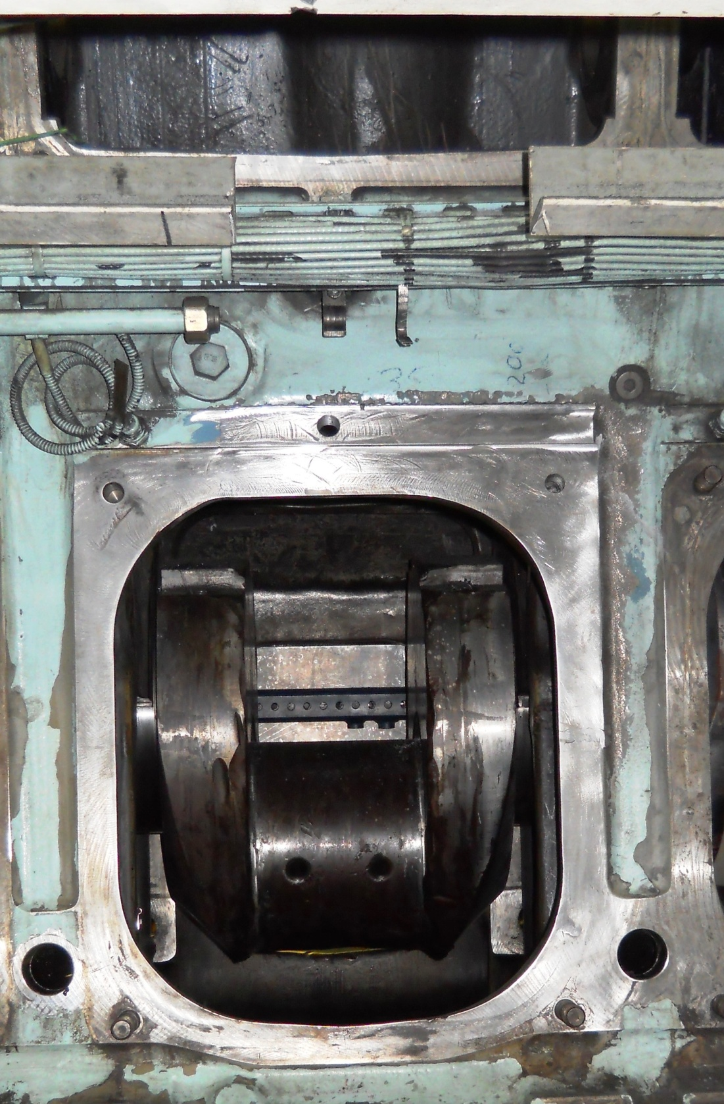
A side inspection door gasket surface repaired and machined

Slide 14
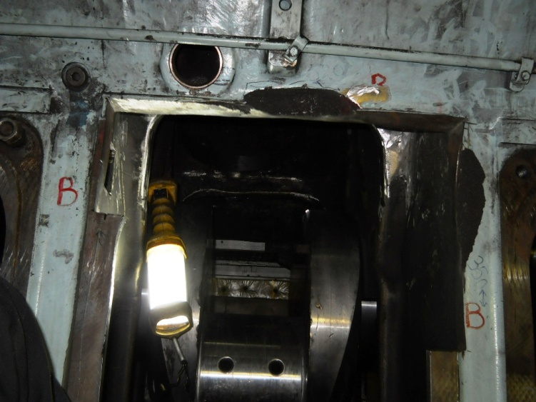
Inspection door B2 damage cut out and still need to cut damaged pocket above door

Slide 15
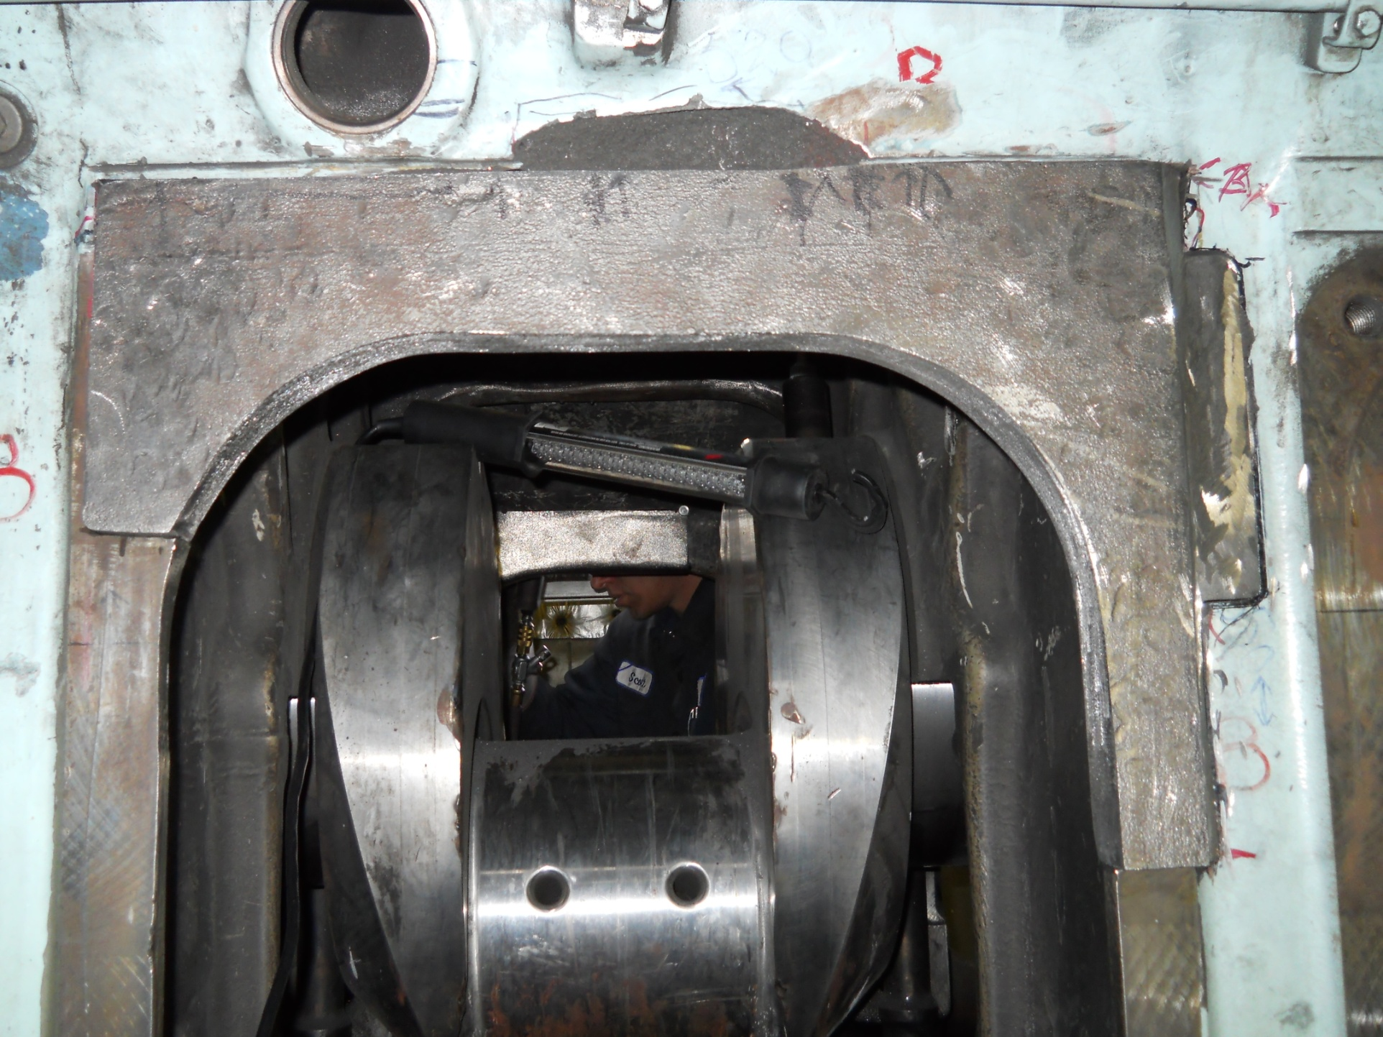
B side inspection gasket surface casting fitted and ready to be metal stitched

Slide 16
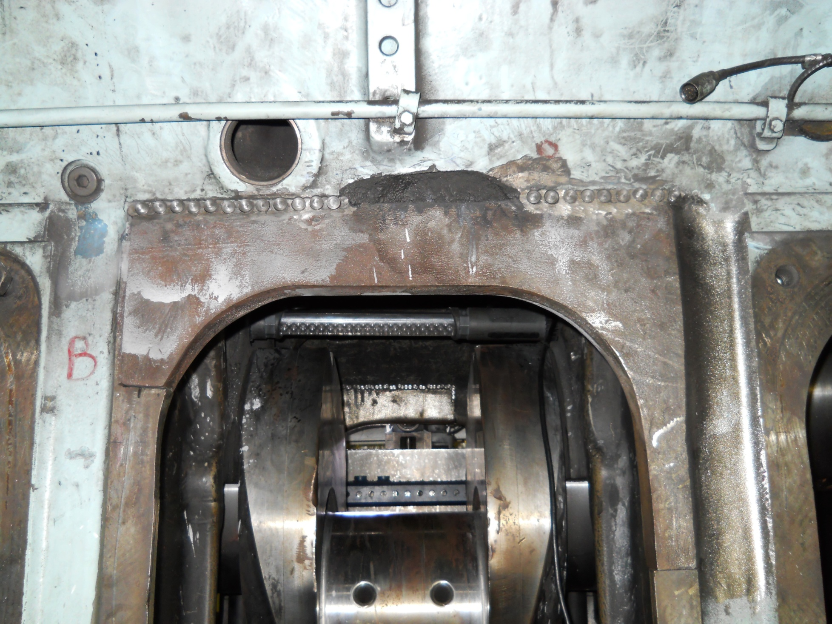
Metal stitching in process on the B side Inspection Door Gasket Surface

Slide 17
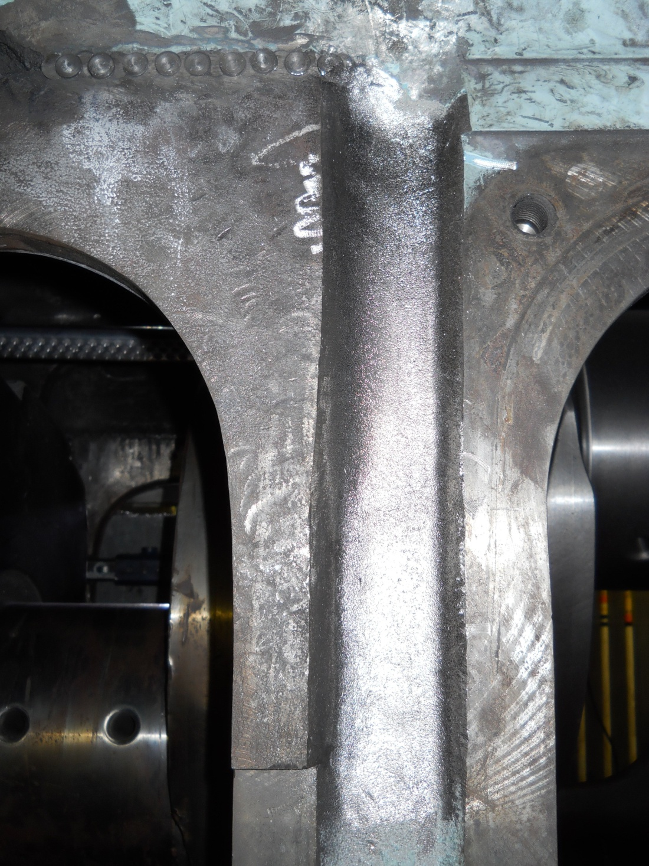
B Side Inspection Door gasket Surface

Slide 18
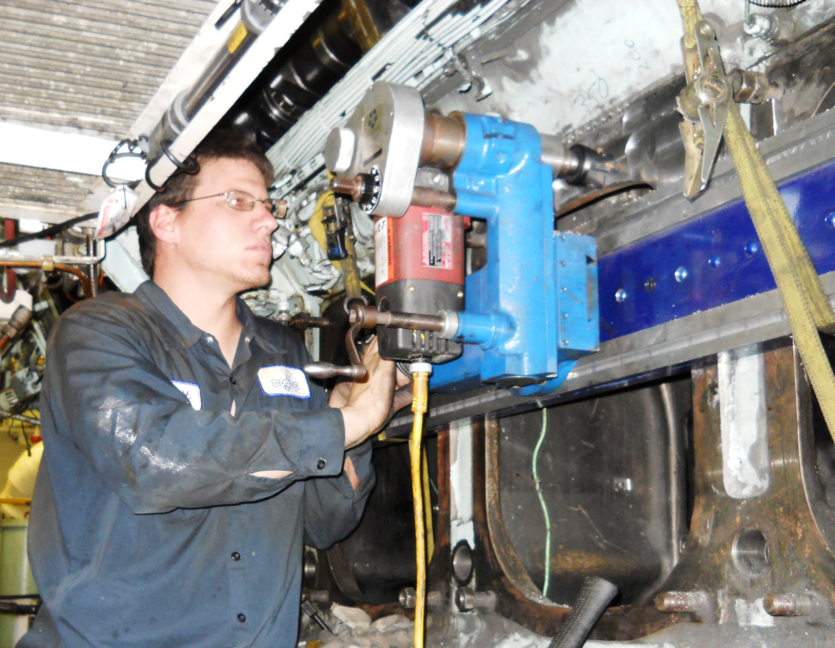
7’ Climax bed Mill machining the gasket surfaces on the inspection door

Slide 19
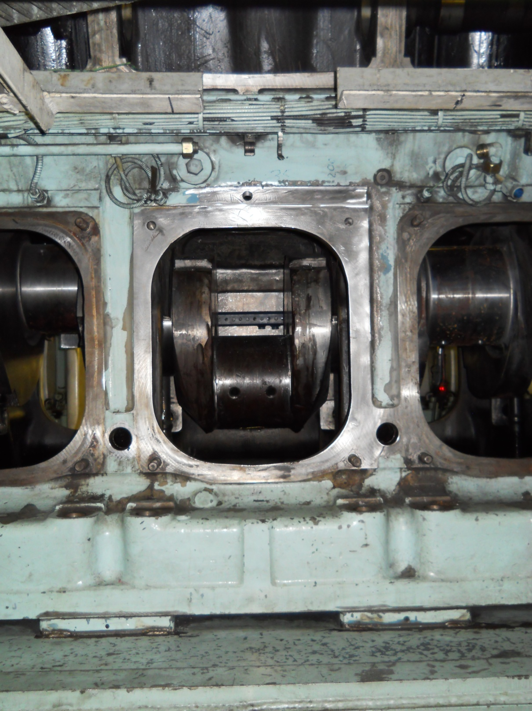

Slide 20
Final repair inspection process
1. LNS technicians performed in‐process and final inspections of each
repair site once the metal stitching process for that area was
concluded.
2. The process involved using a magnetic particle inspection process
with either dry powder or wet particle methods.
3. The metal stitching locks and stitching pins have magnetic properties
that are slightly different from the cast iron so the outline of the
repairs attracts the magnetic powder when a special magnet is
placed on the part with the North and south poles spanning the
repair.
4. This method quickly and easily shows any gaps between the pins or
any crack that may have been missed.
5. If a gap is detected on either side of the repaired wall, additional
stitching pins could have been added to the repair.
6. The final inspection showed no spaces, gaps or cracks at or around
the metal stitching repairs that were repaired.

Slide 21
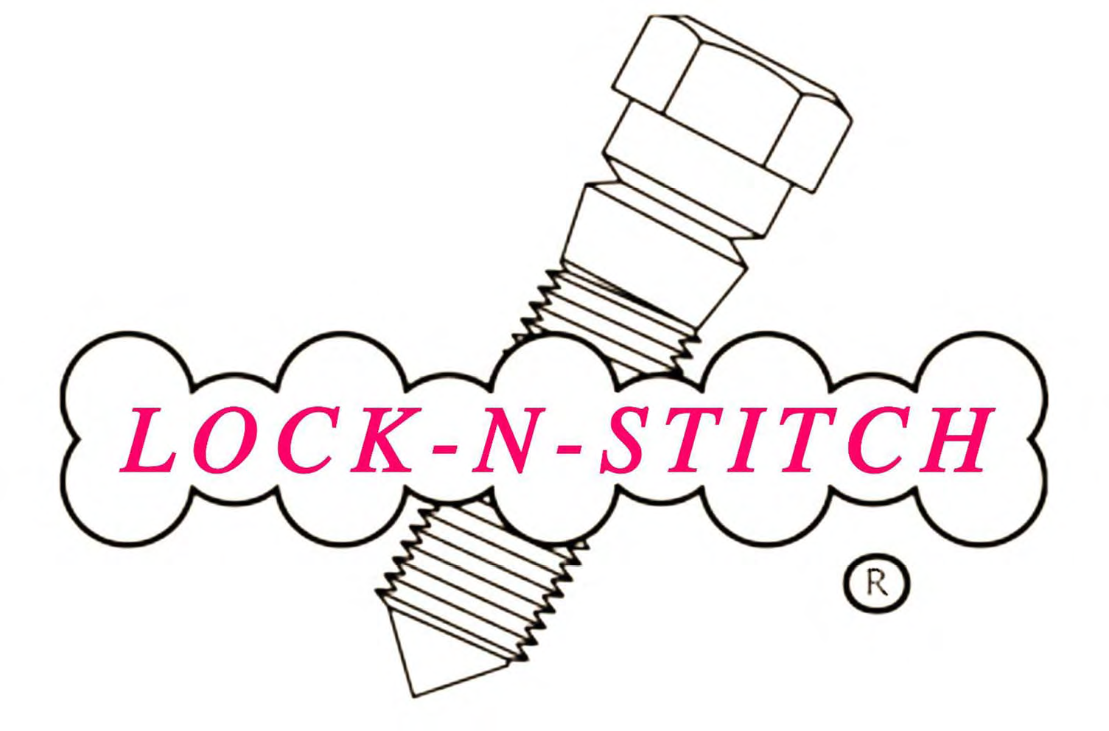
This repair required eight (8) weeks to complete and is guaranteed for one year.

